Slide 1
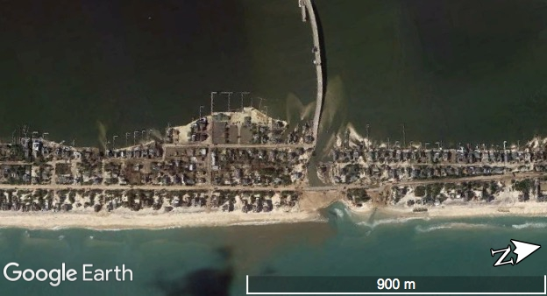
Climate Change Impacts and Solutions: Personal Actions
Rose Palermo
PhD Candidate, MIT/WHOI Joint Program
8/11/19
Girls in Science Summer Program

Slide 2

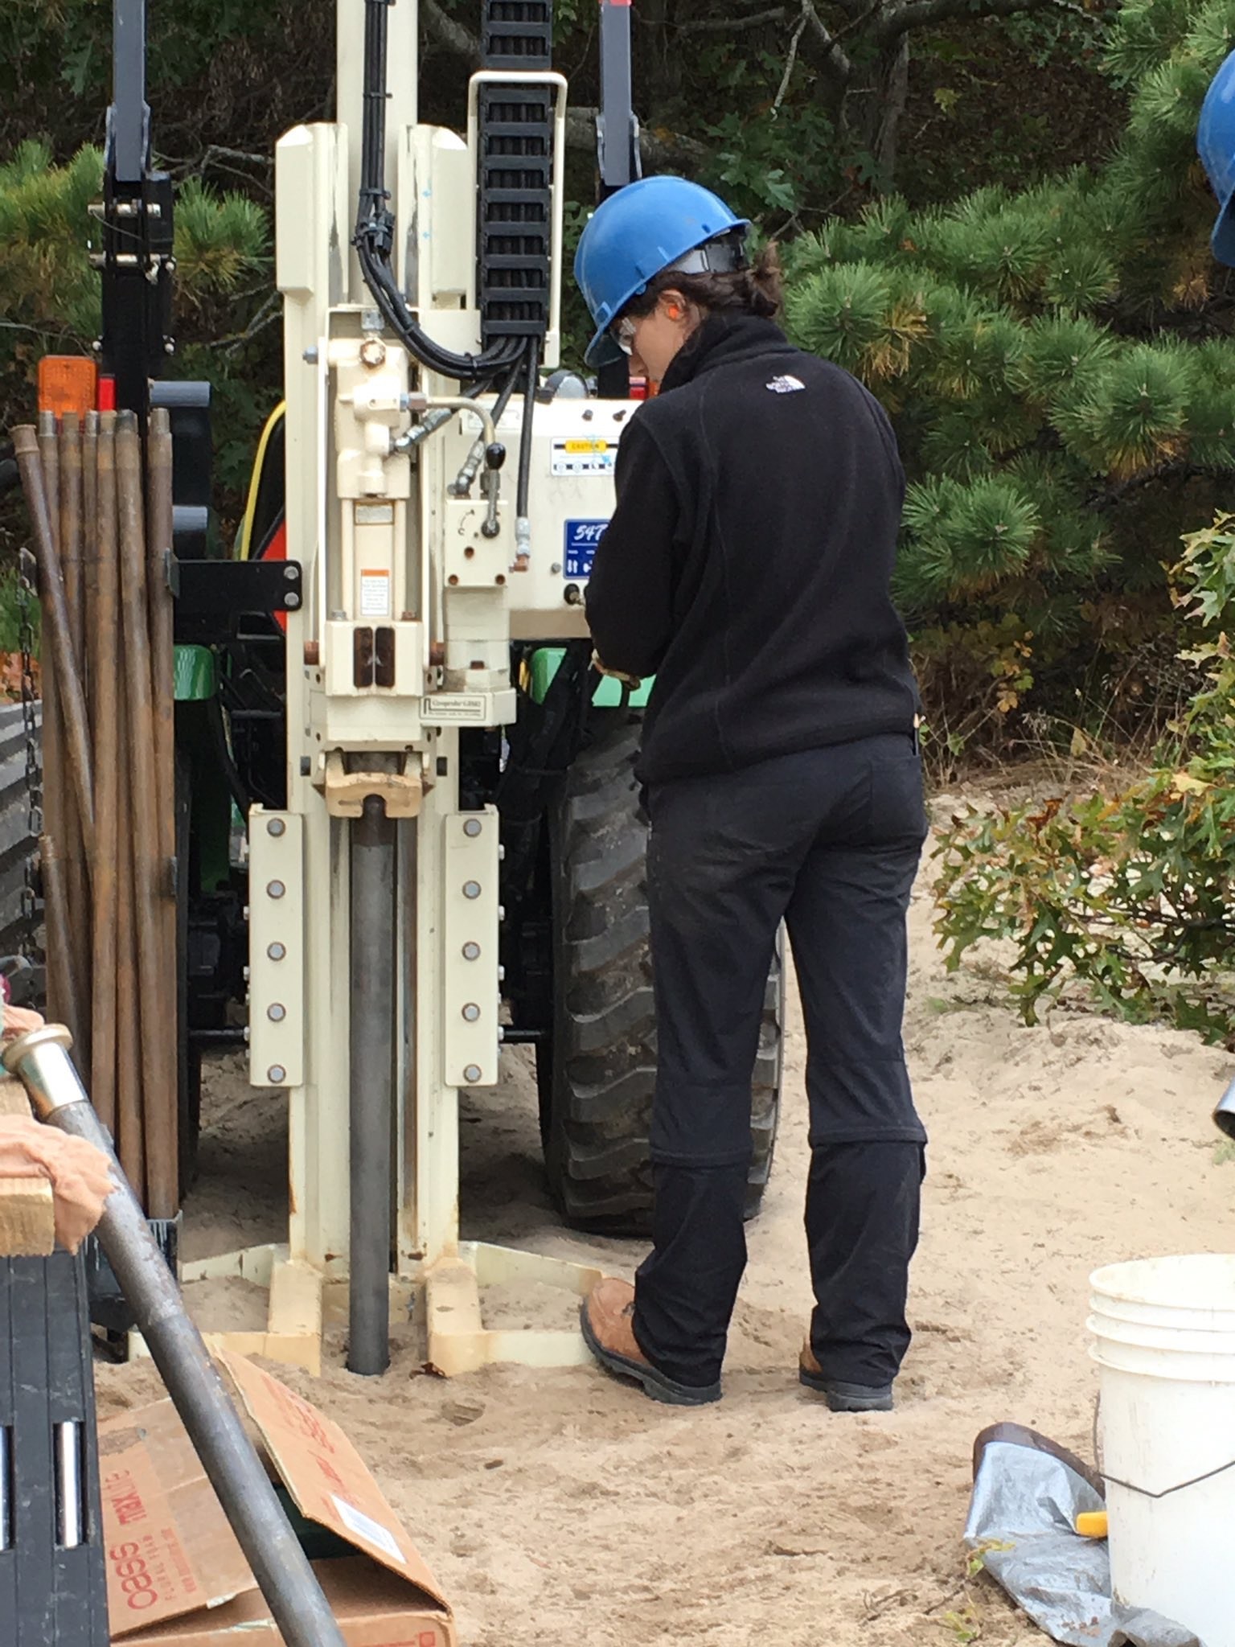
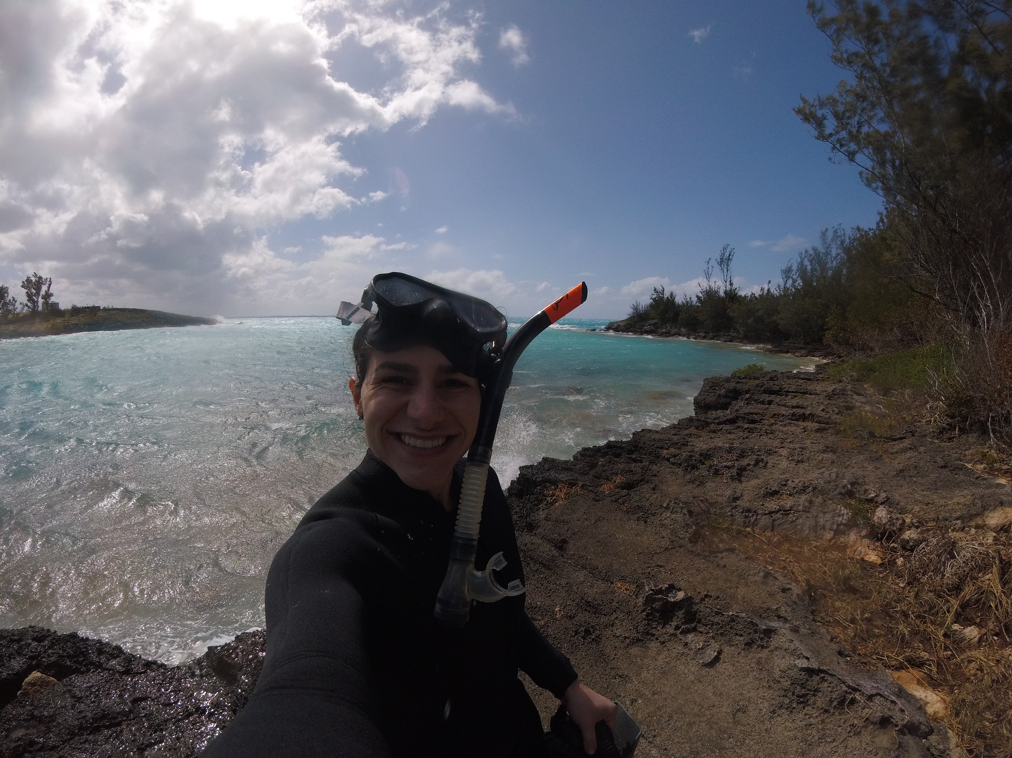
Hi! I’m Rose ☺
How I got into science
  Elementary school teacher
  Finding Geology
  Switching specialties in Graduate School
  Now 4th year of my PhD!
  For fun things I do:
    I have a dog
    I read, ski, cook, and play tennis!

Slide 3
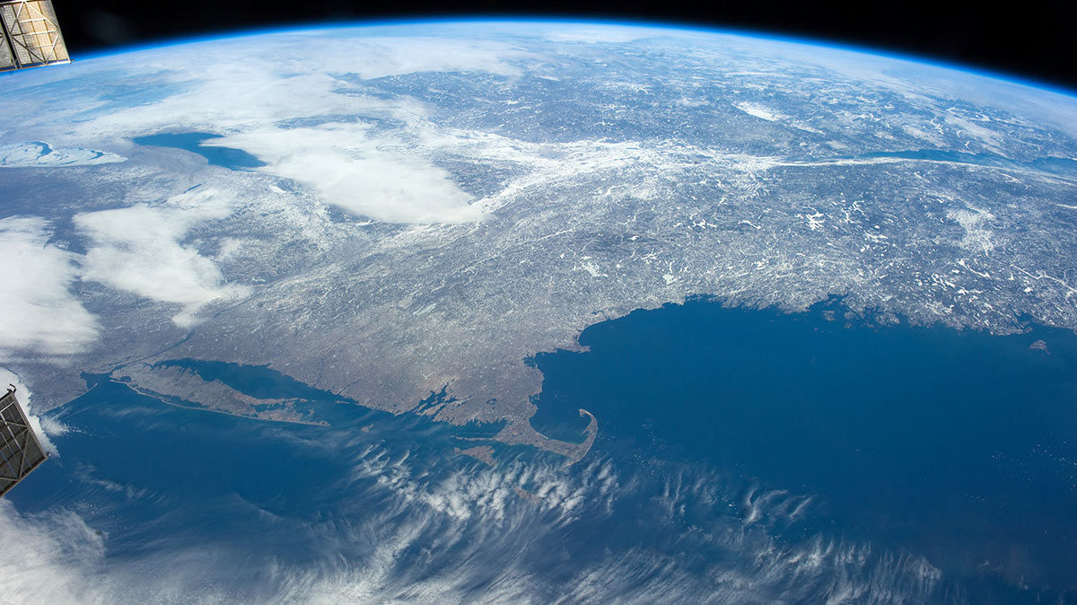
Outline:
Background information
  What is climate? Climate Change?
  What are the major drivers of climate change?
ISS

Slide 4
Outline:
Background information
  What is climate? Climate Change?
  What are the major drivers of climate change?
How is New England impacted by climate change?
ISS

Slide 5
Outline:
Background information
  What is climate? Climate Change?
  What are the major drivers of climate change?
How is New England impacted by climate change?
What can we do to adapt &/or mitigate climate change?
ISS

Slide 6
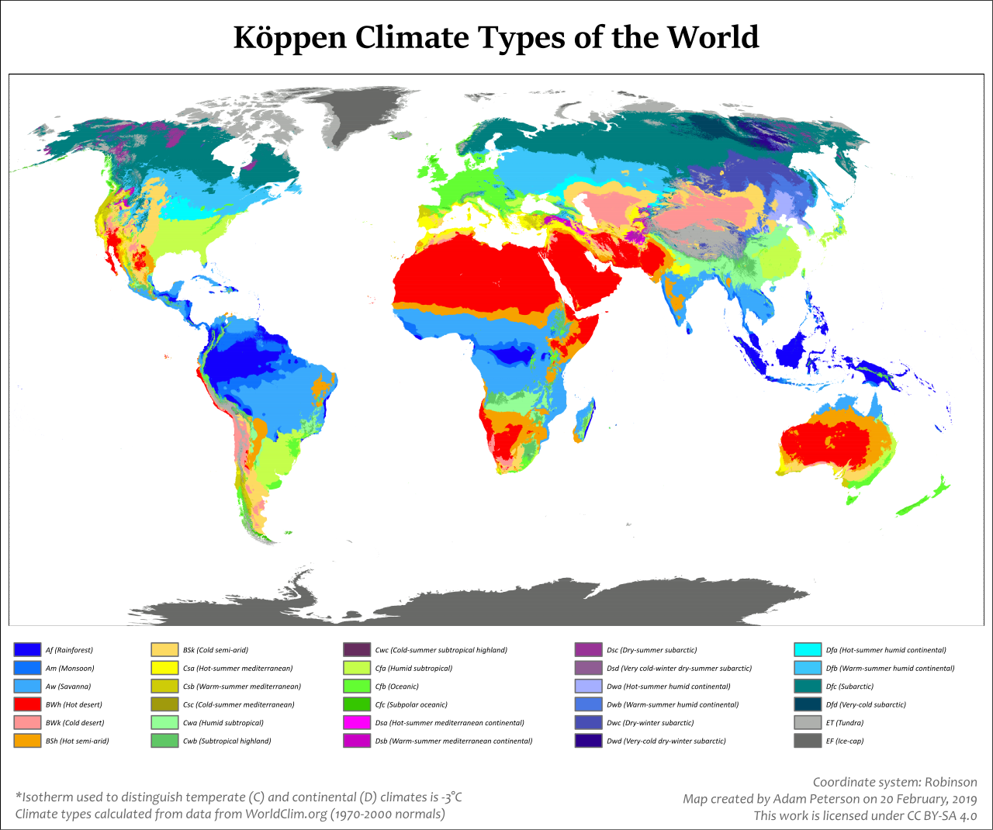
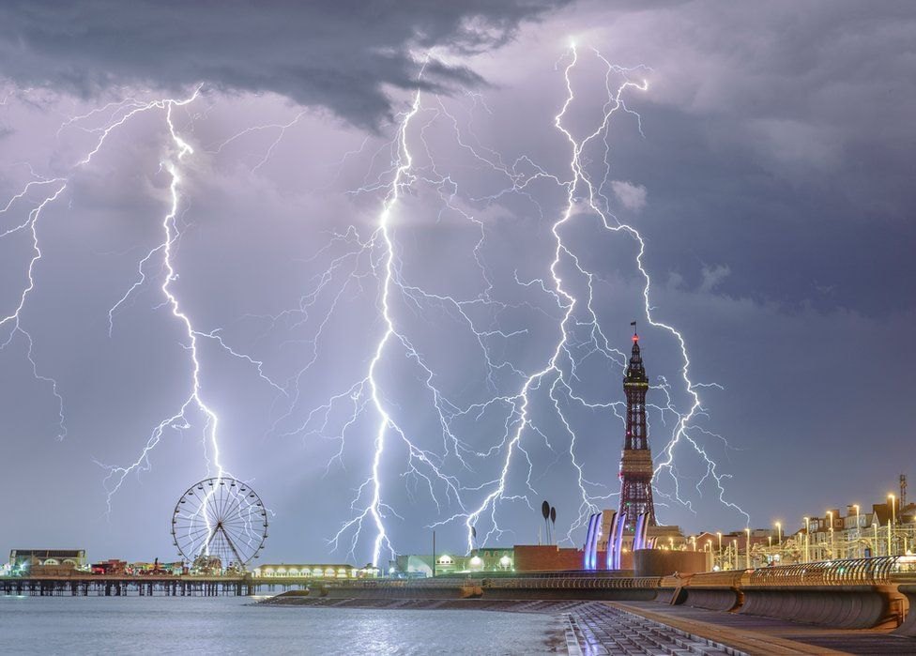
Climate vs. weather
Climate
30 + year pattern of weather. Average state of atmosphere and oceans
Weather
Day to day variation in state of the atmosphere.
BBC

Slide 7
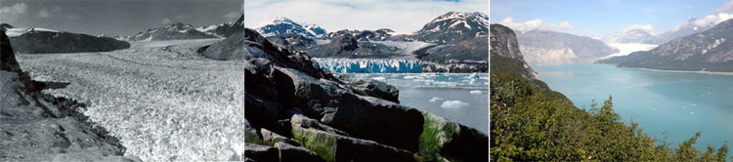
What does climate change mean?
Climate change is the variation in global or regional climates over time
Muir Glacier in Alaska
NSIDC
1941
1976
2004

Slide 8
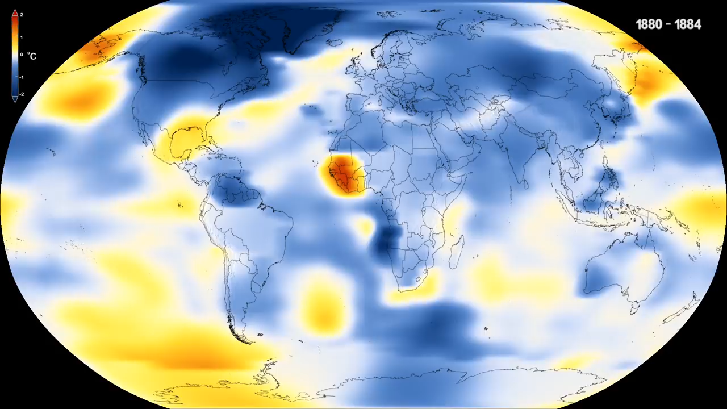
How do we know the climate is changing?
Record of global temperatures

Slide 9
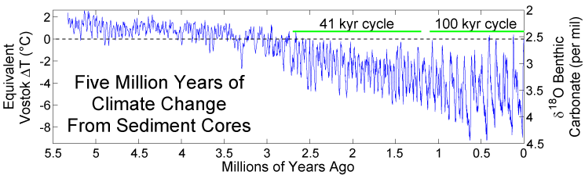
How do we know the climate is changing?
Record of global temperatures
Lisiecki & Raymo 2005

Slide 10
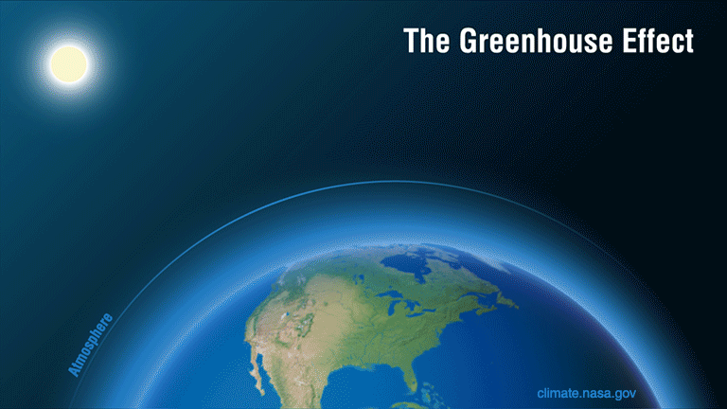
What is changing it? CO₂ & The Greenhouse Effect

Slide 11
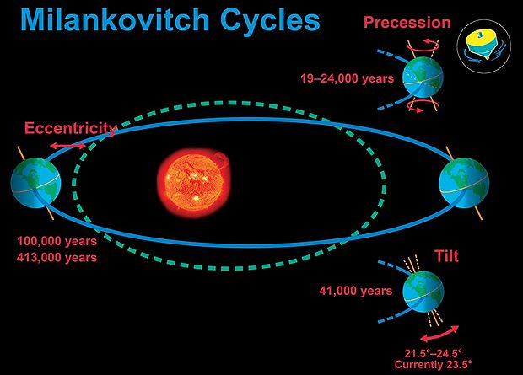
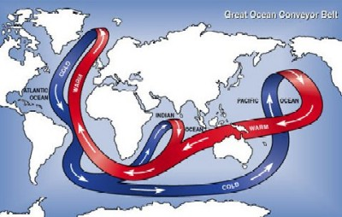
Natural variation in Earth’s climate
Earth’s climate changes due to natural dynamics
  Changes in Earth’s orbit around the sun
  Variations in solar radiation
  Natural feedbacks in ocean & atmosphere
Universe Today
Environmental Literacy Council

Slide 12
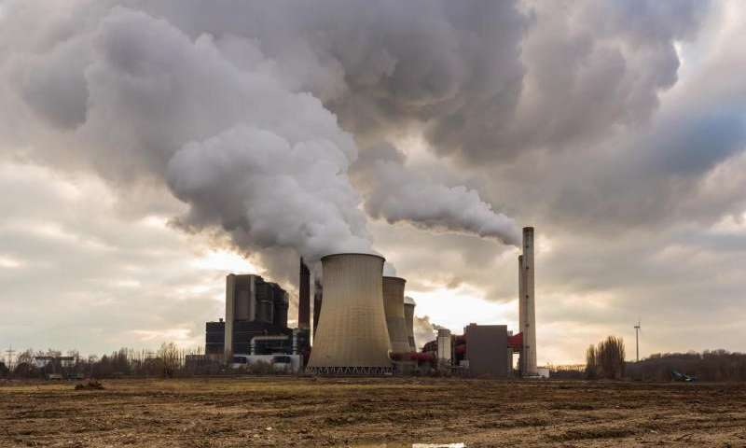
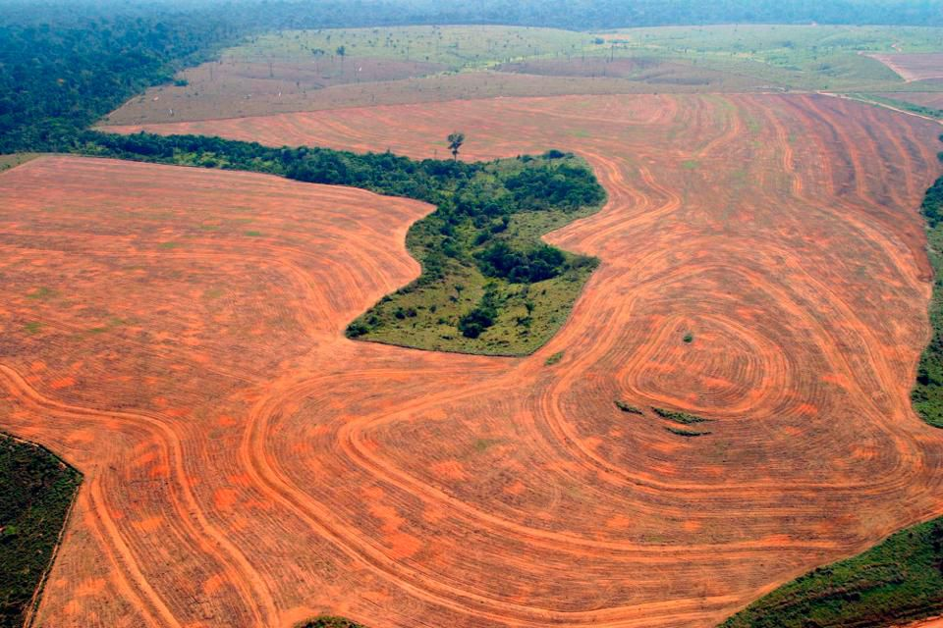
Anthropogenic climate change
BUT Modern Climate Change is caused BY HUMANS
  Due to excess carbon emissions into the atmosphere
  The excess carbon is not coming from natural emissions processes (volcanoes, wildfires), but from humans burning fossil fuels (3/4) and deforestation and agriculture (1/4)

Slide 13
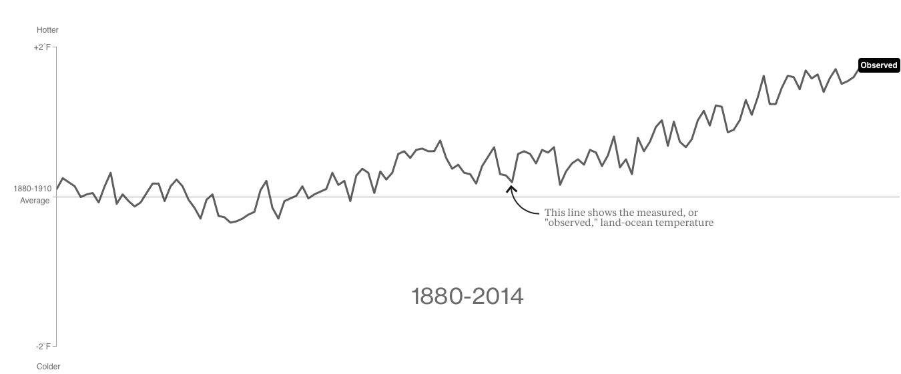
How do we know humans are the cause?
Here’s some Climate models put together by NASA Godard Institute for Space Science (figures from bloomberg article in resources slide)

Slide 14
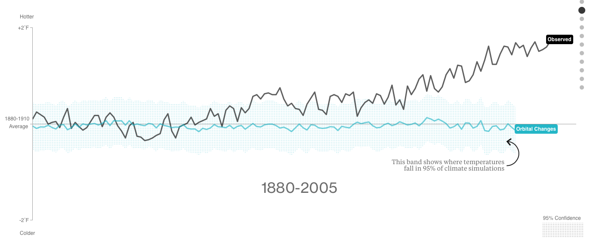

Slide 15
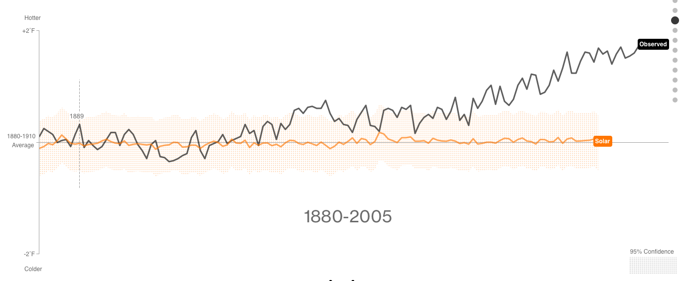

Slide 16
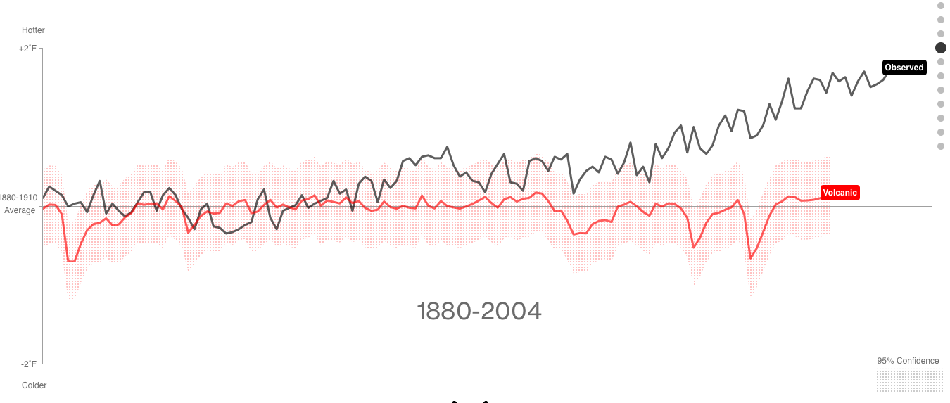

Slide 17
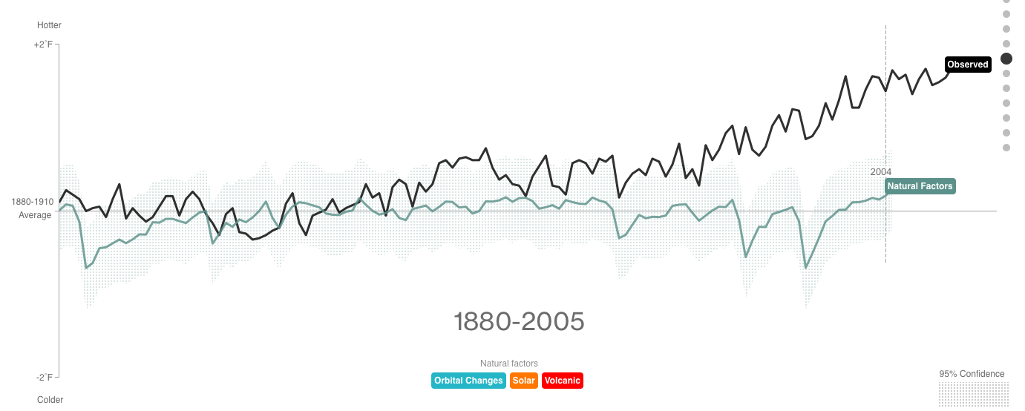
All natural factors falls short

Slide 18
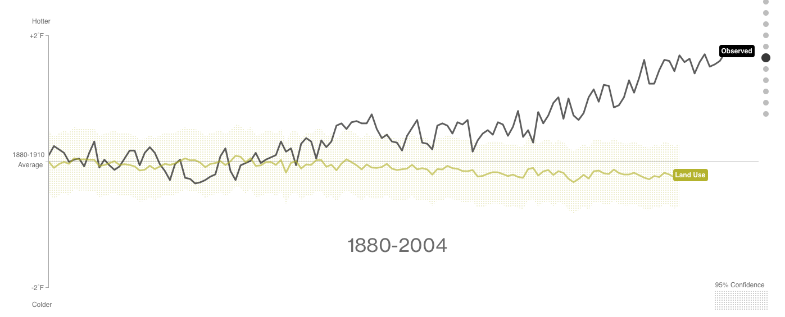

Slide 19
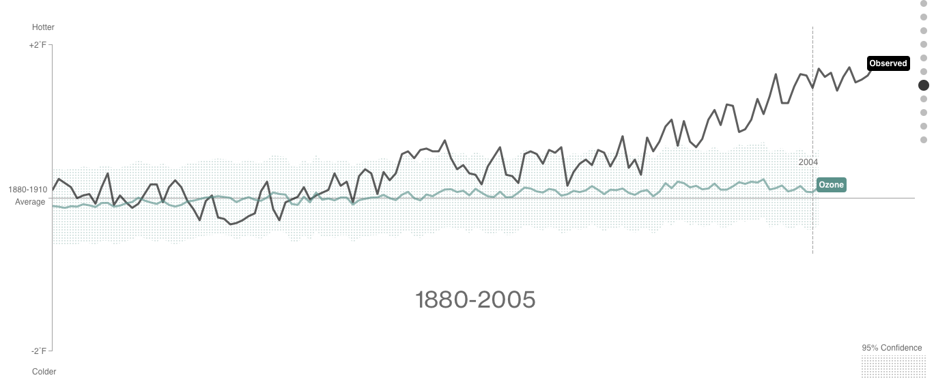

Slide 20
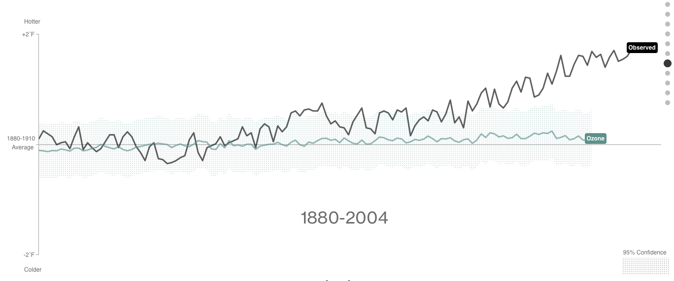

Slide 21
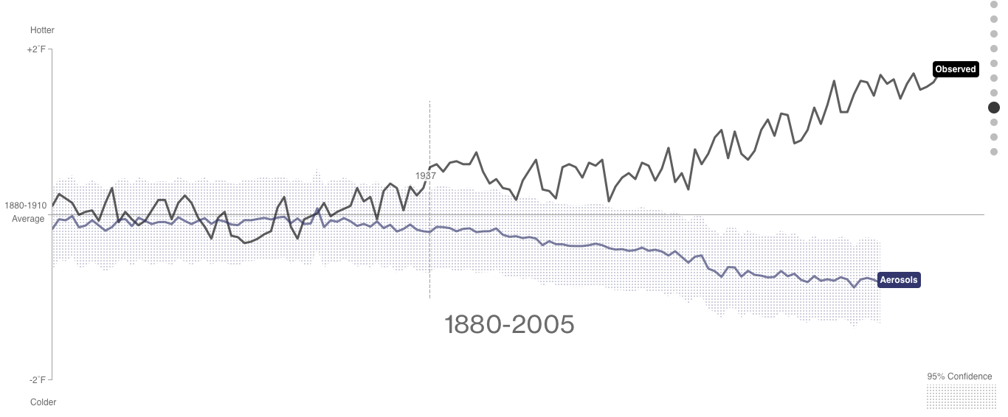
What does this mean for New England?
Notes:
Like sulfate aerosols. They cool the earth but also cause acid rain.

Slide 22
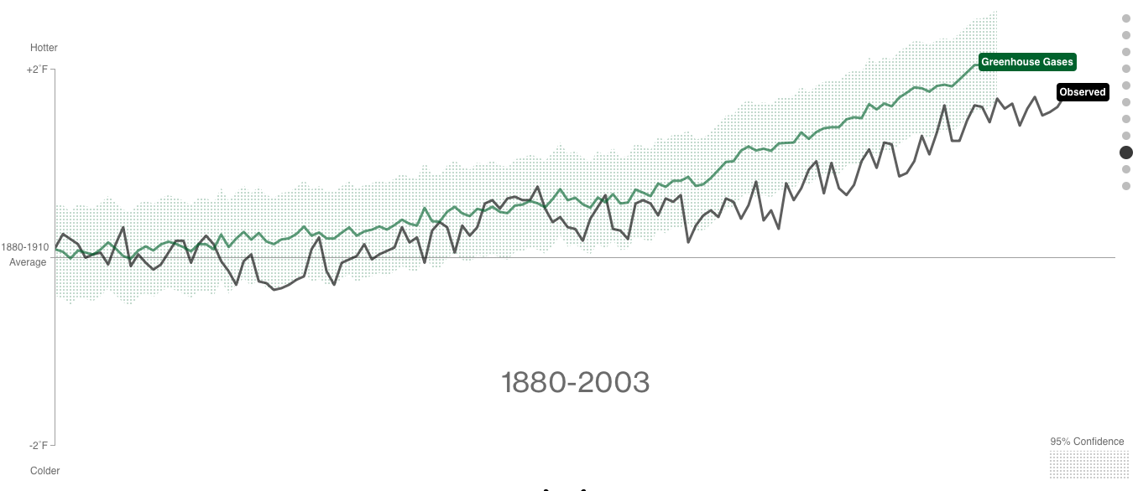

Slide 23
ATMOSPHERIC CO₂ IS 40% HIGHER THAN IT WAS IN 1970!!

Slide 24
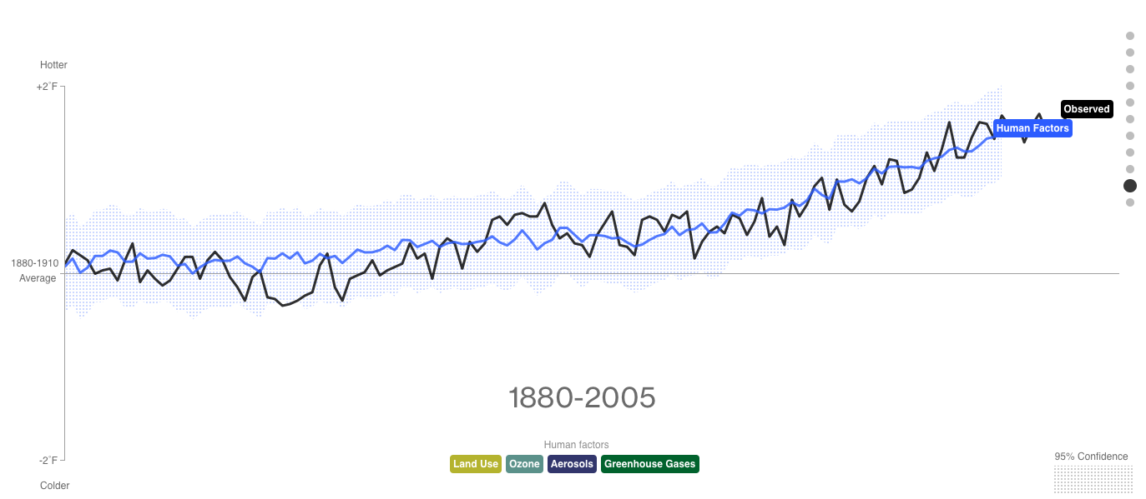
All human factors line up with observations

Slide 25
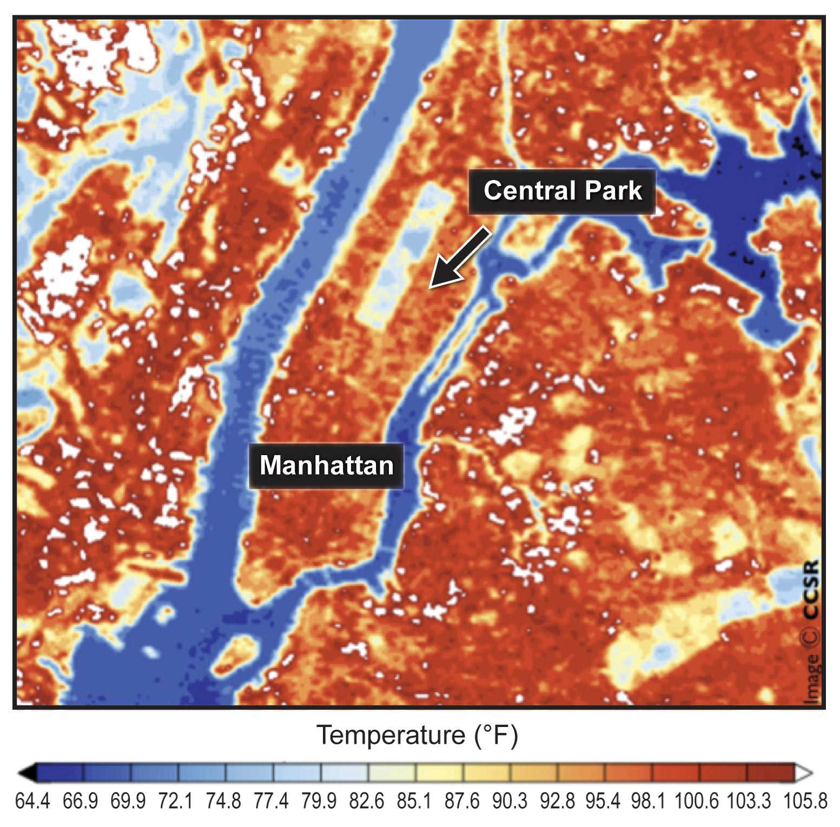
What does this mean for New England?
Heat Waves
US National Climate Assessment
US NCA

Slide 26
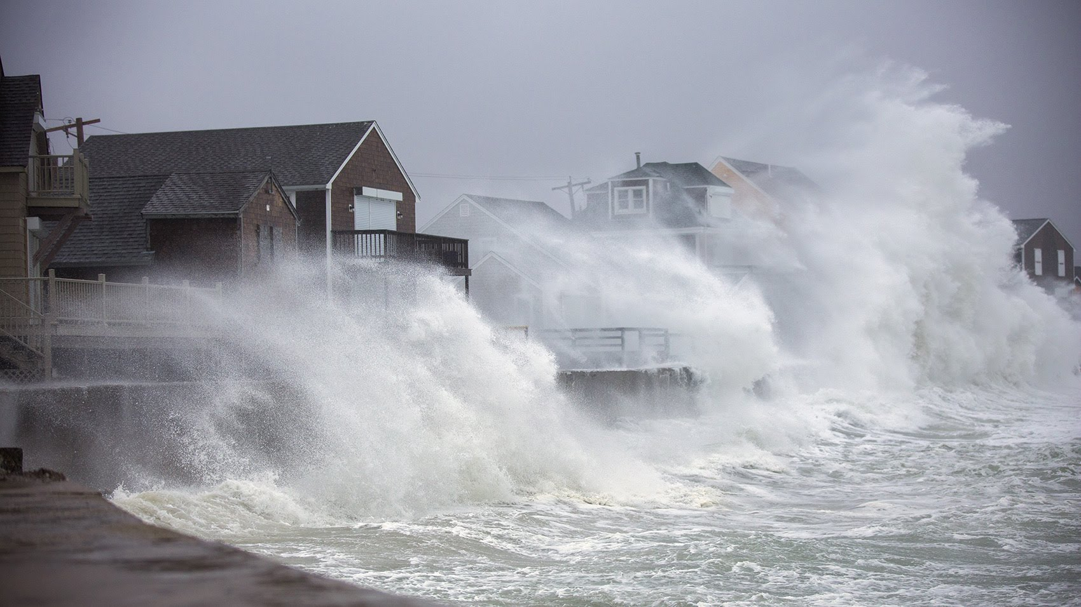
What does this mean for New England?
Heat Waves
Coastal Flooding
  Sea level rise
  Storms
WBUR
US National Climate Assessment

Slide 27
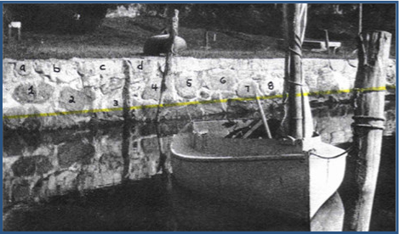
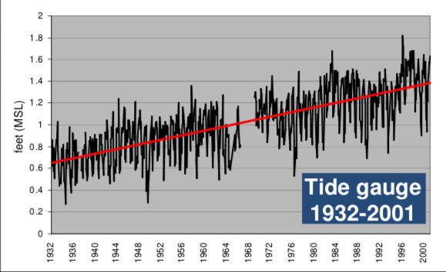
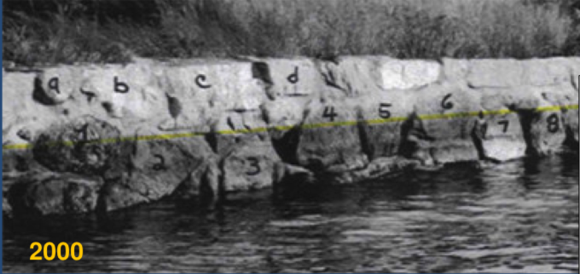
Sea level rise in Woods Hole
1990
Relative sea level rise in Woods Hole has risen ~25-30 cm (10-12 in) over the past 100 years

Slide 28
What does this mean for New England?
Heat Waves
Coastal Flooding
  Sea level rise
  Storms
River Flooding
US National Climate Assessment

Slide 29
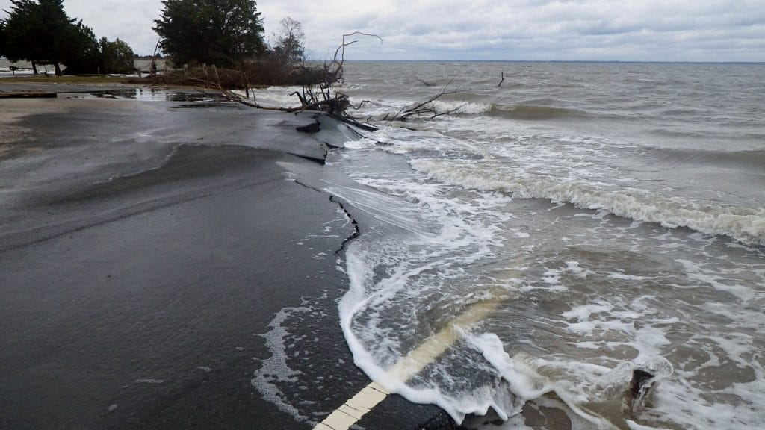
What does this mean for New England?
Heat Waves
Coastal Flooding
  Sea level rise
  Storms
River Flooding
Stressed Infrastructure
WHOI
US National Climate Assessment

Slide 30
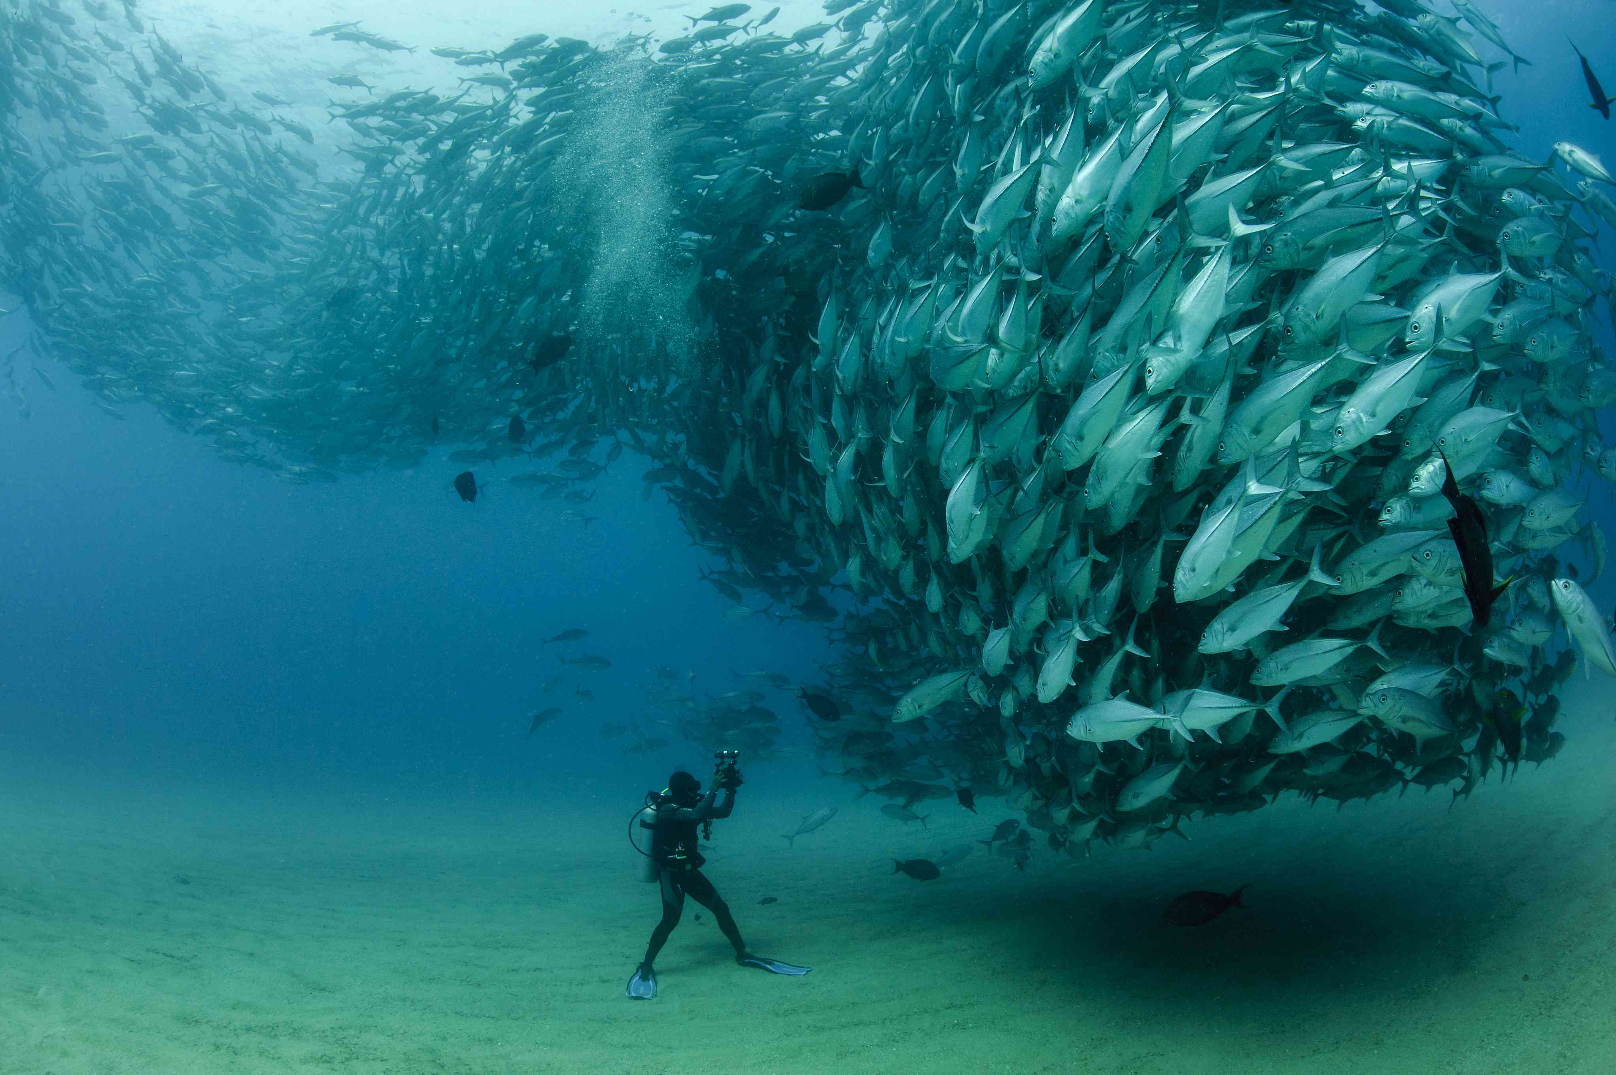
What does this mean for New England?
Heat Waves
Coastal Flooding
  Sea level rise
  Storms
River Flooding
Stressed Infrastructure
Agricultural and Ecosystem Impacts
Scripps
US National Climate Assessment

Slide 31
What does this mean for New England?
Heat Waves
Coastal Flooding
  Sea level rise
  Storms
River Flooding
Stressed Infrastructure
Agricultural and Ecosystem Impacts
MORE PLANNING AND ADAPTATION!
US NCA
WBUR
US National Climate Assessment
Scripps

Slide 32

WHAT CAN WE DO?
documentdeconstruction

Slide 33
Track your carbon footprint
Tracking your footprint lets you know where you are contributing the most carbon in your daily life and where is easy to cut back.
  Fans> my AC unit
Carbon offsets – students at MIT are currently petitioning our department to offset our conference travel.

Slide 34

REDUCE, REUSE, then Recycle

Slide 35

Call your representatives!
Even if you’re too young to vote, you’re not too young to advocate for the future of our Earth!
techcrunch

Slide 36
Resources
Intergovernmental Panel on Climate Change (IPCC)
  https://www.ipcc.ch
US National Climate Assessment
  https://nca2014.globalchange.gov
National Ocean and Atmospheric Administration (NOAA)
  https://www.noaa.gov/education/resource-collections/climate-education-resources
  https://www.noaa.gov/categories/climate-change
Global Weirding with Katharine Hayhoe
  https://www.youtube.com/channel/UCi6RkdaEqgRVKi3AzidF4ow
Figures of NASA-GISS Model Data: https://www.bloomberg.com/graphics/2015-whats-warming-the-world/?fbclid=IwAR0MQ25-2GGDY0DwIvFFutozQH0f5FFcAm4w32Q5xPyR3YtcYHlMRa4D3p8
NASA Godard Institute for Space Studies (GISS)
  https://www.giss.nasa.gov
  https://data.giss.nasa.gov/gistemp/graphs_v3/
NOAA Marine Debris Program (learn about land/marine waste in the ocean)
  https://marinedebris.noaa.gov

Slide 37
More information from your questions!

Slide 38
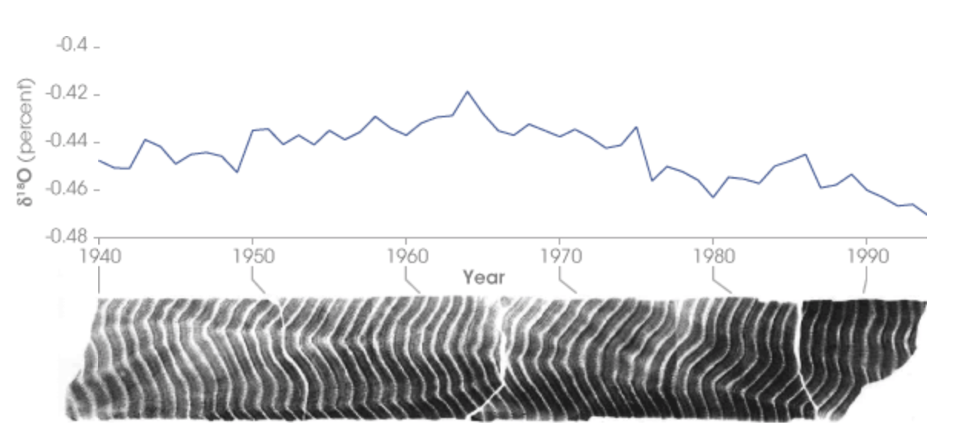
Oxygen Isotopes
https://www.seas.harvard.edu/climate/eli/research/equable/isotope.html
https://www.seas.harvard.edu/climate/eli/research/equable/evidence_foram.html
https://earthobservatory.nasa.gov/features/Paleoclimatology_OxygenBalance

Slide 39
Melting all of the ice caps
If we did melt all of the ice, I guessed it would take at least 1,000 years. I found other sources that say more than 5,000.
What we know: the polar regions are warming faster than the rest of the planet. And the rate of warming is increasing (getting warmer faster). There are carbon stores in permafrost (frozen ground) that will be emitted into the atmosphere once the permafrost melts, contributing more to atmospheric CO₂ and therefore to climate change.
The Earth has natural feedbacks that keep us out of a “greenhouse” Earth or a “Snowball” Earth. (These mechanisms might not be enough in this scenario, since we are emitting CO2 and warming the planet SO quickly).
  Info on balance between carbon (in the atmosphere) and silicate weathering (rock weathering):
    As rocks weather, it takes carbon out of the atmosphere by transporting it as an ion to the oceans. It then precipitates as shells and marine sediments (calcium carbonate). Eventually, these marine rocks get subducted into the ocean and turned into mantle/magma. This magma will rise and eventually erupt as a volcano!
    The feedback to keep the earth from over heating is that when it rains more, more rocks weather, so more carbon is taken out of the atmosphere and trapped in marine sediments. But, if we put carbon in the atmosphere to quickly, this mechanism won’t be able to keep us cool.
    The feedback to keep us warm is that when it gets cold, less weathering occurs and more carbon can stay in the atmosphere.
    https://en.wikipedia.org/wiki/Carbonate–silicate_cycle

Slide 40
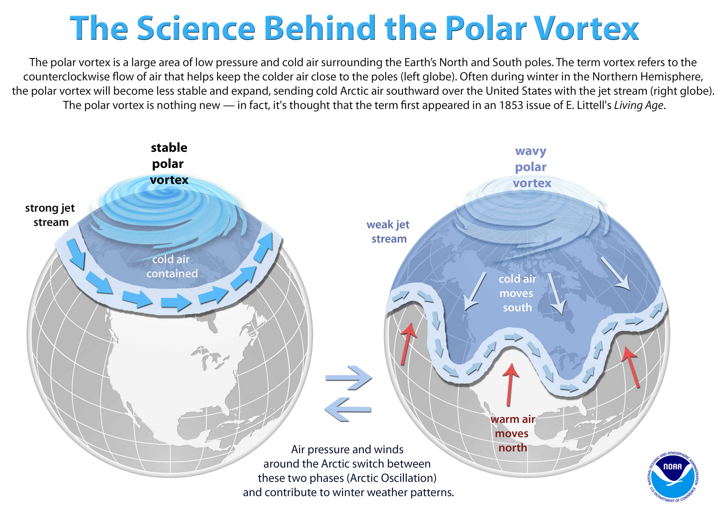
Where in the world is getting colder because of climate change?
We just had a very cold winter because of climate change! Remember the “Polar Vortex”?
  The polar vortex is the cold air surrounding the poles. When the climate is stable, the polar vortex is contained in the poles. With climate change, this polar vortex becomes unstable, leading to cold spells further south than there should be!
  This is polar vortex is becoming unstable because the arctic is warming

