Slide 1
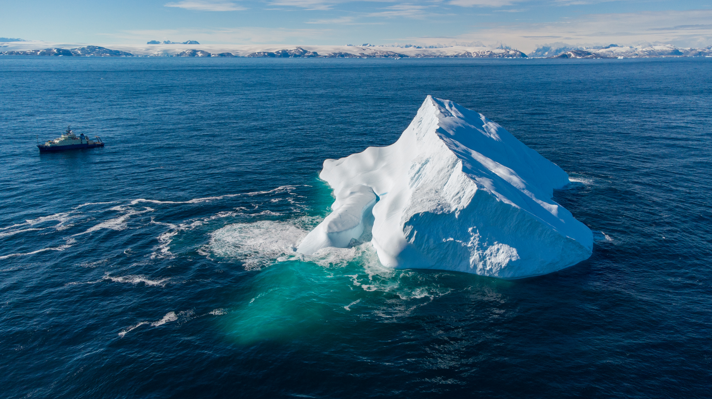



Earth System Telephone:
Why does the world care about icebergs in the Atlantic?
Kaden Martin
WHOI Postdoctoral Scholar
From Ice Core to Ocean Floor Workshop
June 5th, 2026

Slide 2
Overview
Teleconnections
What is a teleconnection? How does it relate to Heinrich Events?
NGSS: HS-ESS2-2 Earth Systems
Downstream Impacts
What are some of the key global impacts of Heinrich Events? How do these impacts happen?
NGSS: MS-ESS2-2 Earth Systems, HS-ESS2-4 Earth Systems

Slide 3
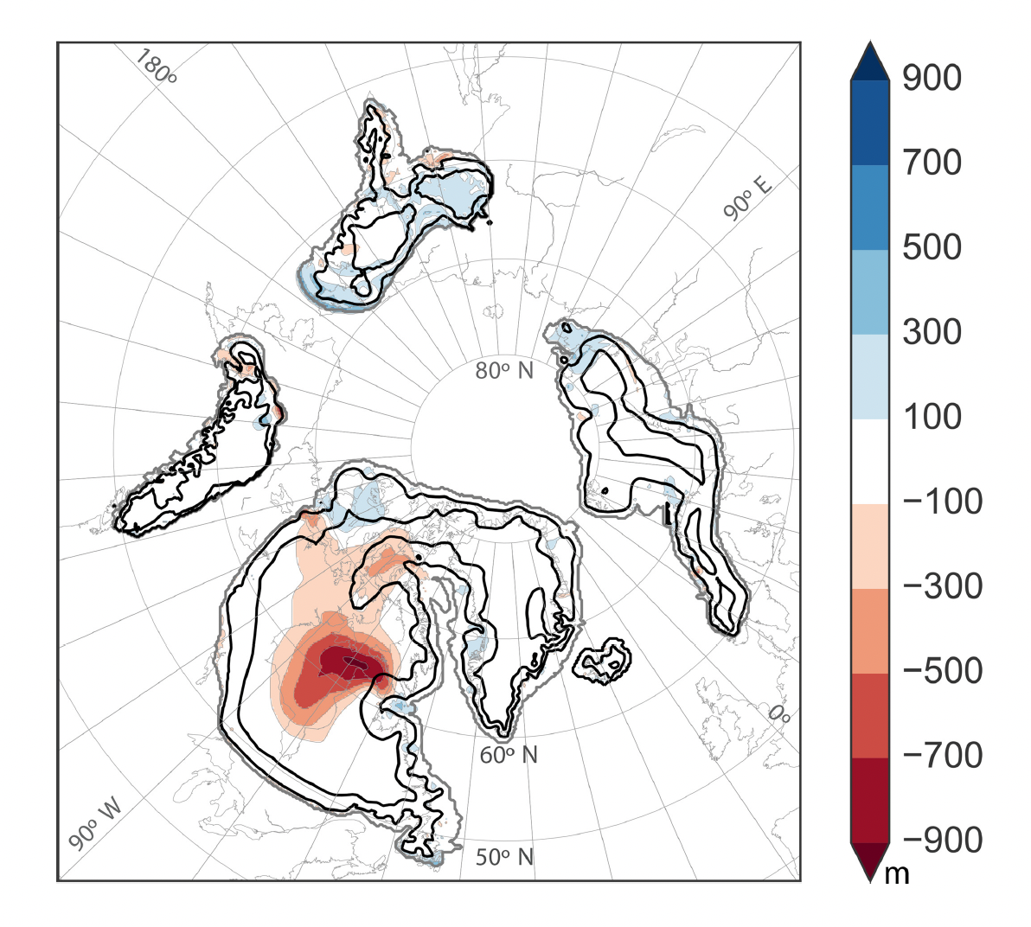
Local Impacts
Changes in ice sheet topography
Zeimen et al., (2019)

Slide 4
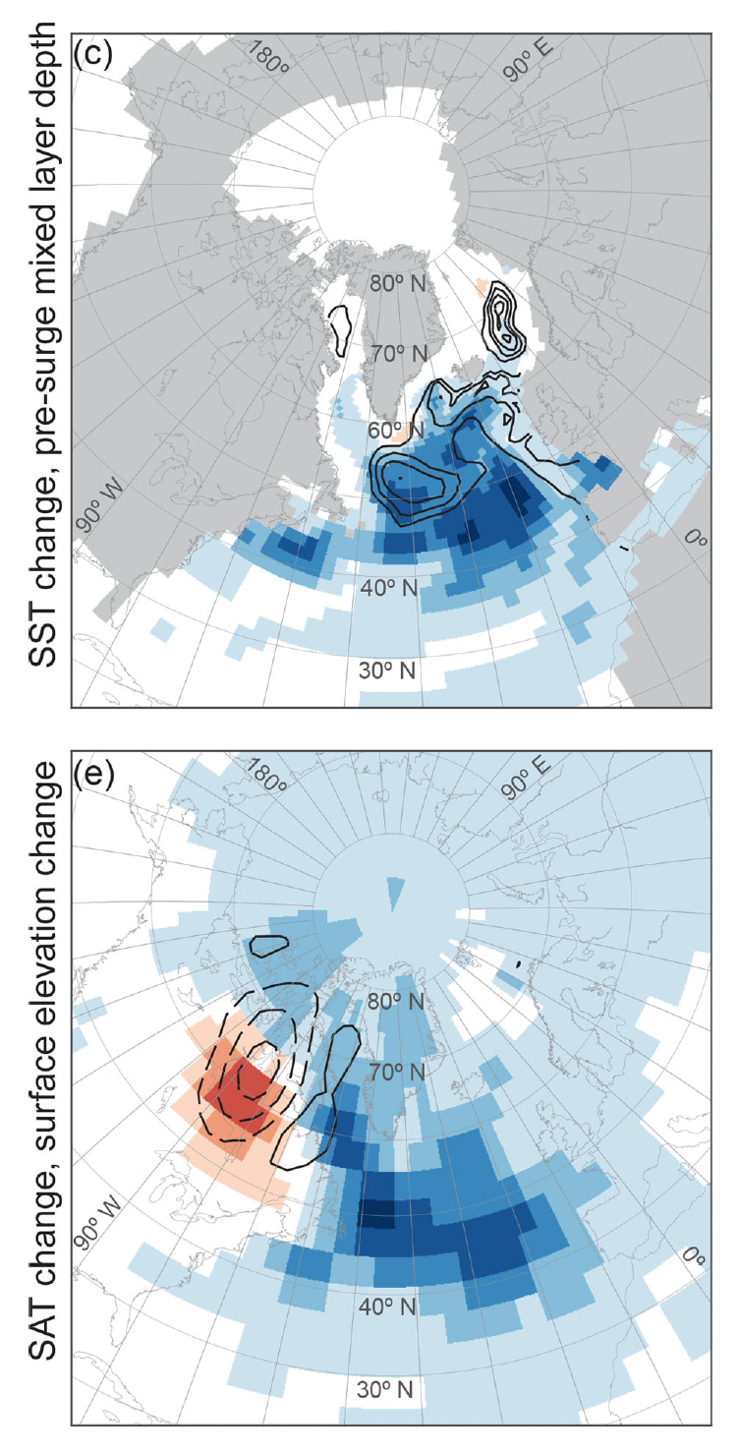
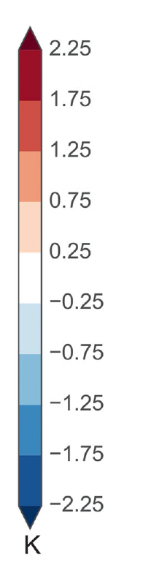
Local Impacts
Changes in ice sheet topography
Sea surface cooling across the North Atlantic
Colder air temperatures across the northern high latitudes
Zeimen et al., (2019)

Slide 5
Teleconnections
A teleconnection is a climate coupling that occurs over long distances
  ie, a change in one place causes a change in another
There is a wide range of different teleconnections in the climate system, acting on fast and slow timescales
Are there any climate phenomenon that fit these patterns?

Slide 6
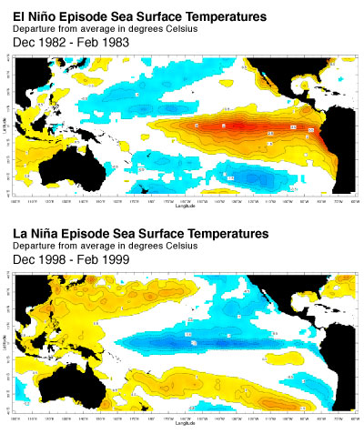
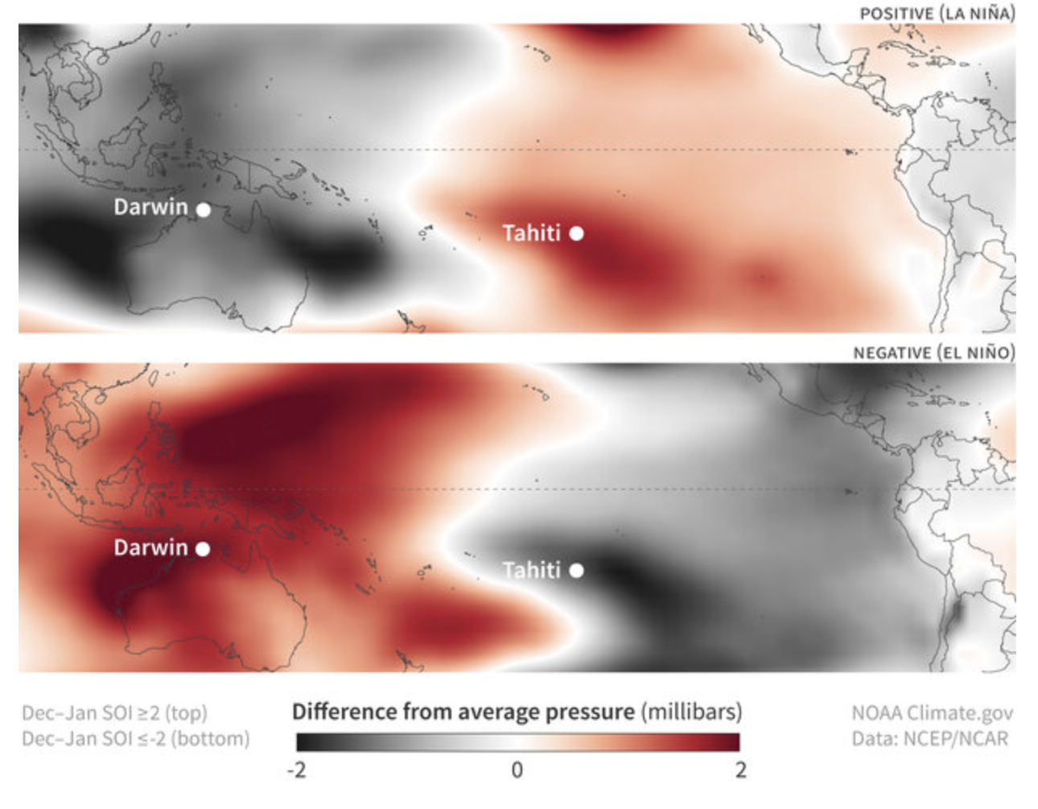
El Niño!
ENSO (El Niño Southern Oscillation) has some the most impactful teleconnections of a climate mode we can observe
https://iri.columbia.edu/our-expertise/climate/enso/enso-essentials/

Slide 7
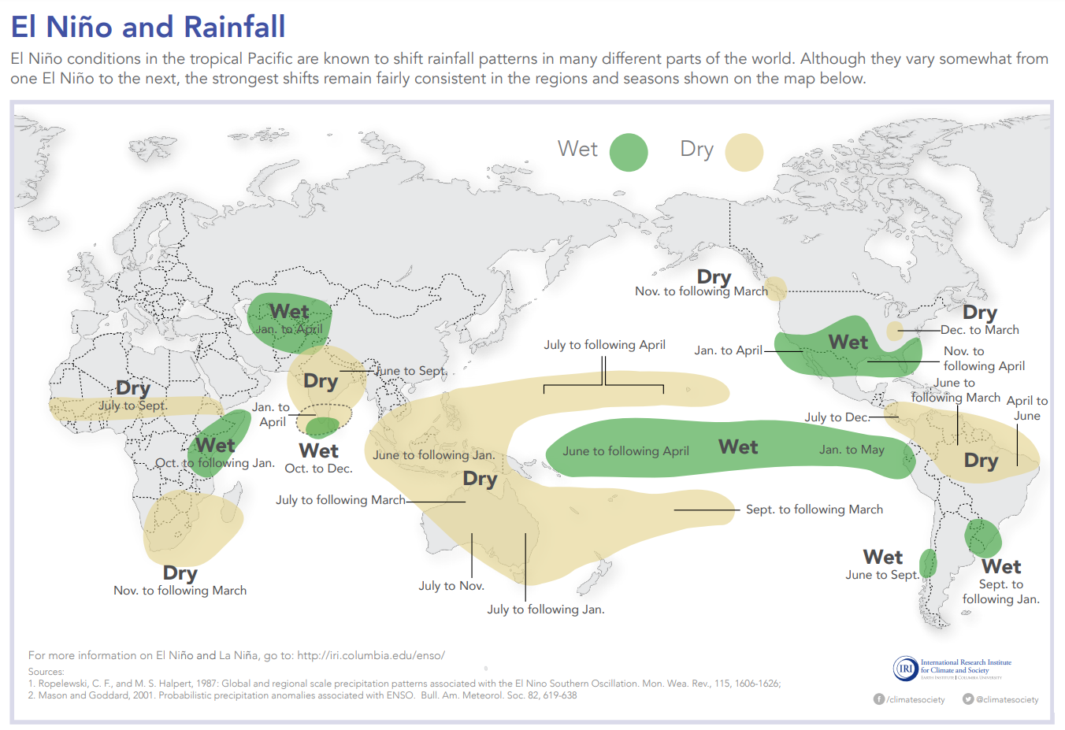
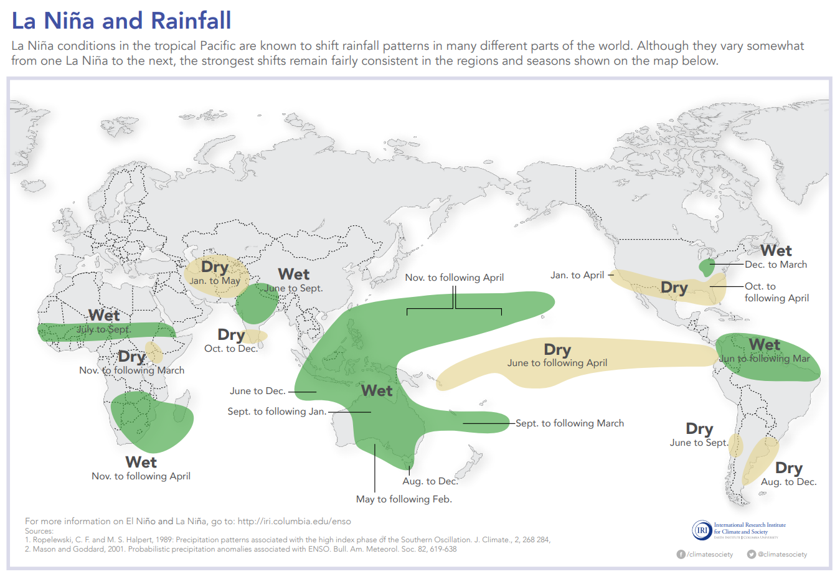
ENSO Teleconnections
https://iri.columbia.edu/our-expertise/climate/enso/enso-essentials/

Slide 8
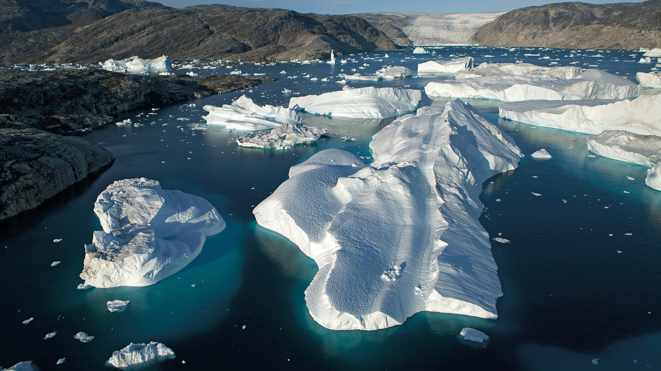
So what?
We know that Heinrich Events are associated with the release of icebergs and cooling in the North Atlantic
So how does this process impact the rest of the world?
To Answer this, we need to take a closer look at the North Atlantic!

Slide 9
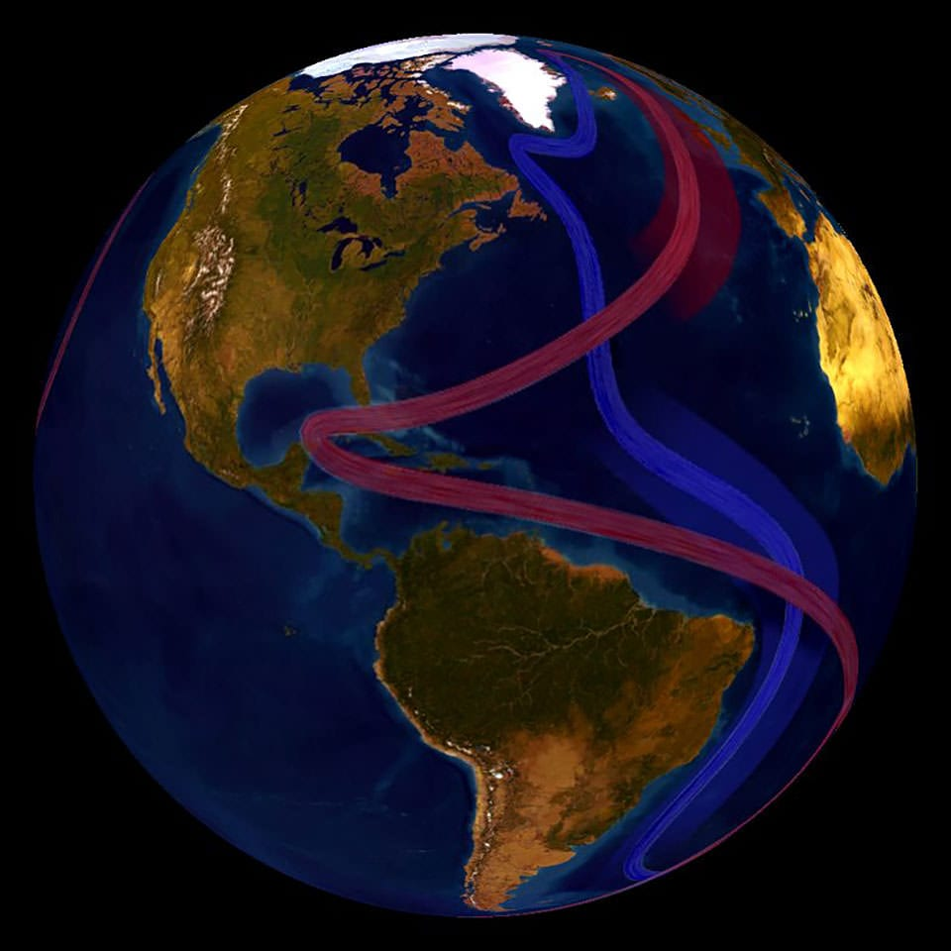
Atlantic Meridional Overturning Circulation
Or AMOC!
A key component of global ocean circulation
AMOC brings warm surface waters northward in the Atlantic, and returns them as cold deep water towards the Southern Ocean
https://oceanservice.noaa.gov/facts/amoc.html

Slide 10
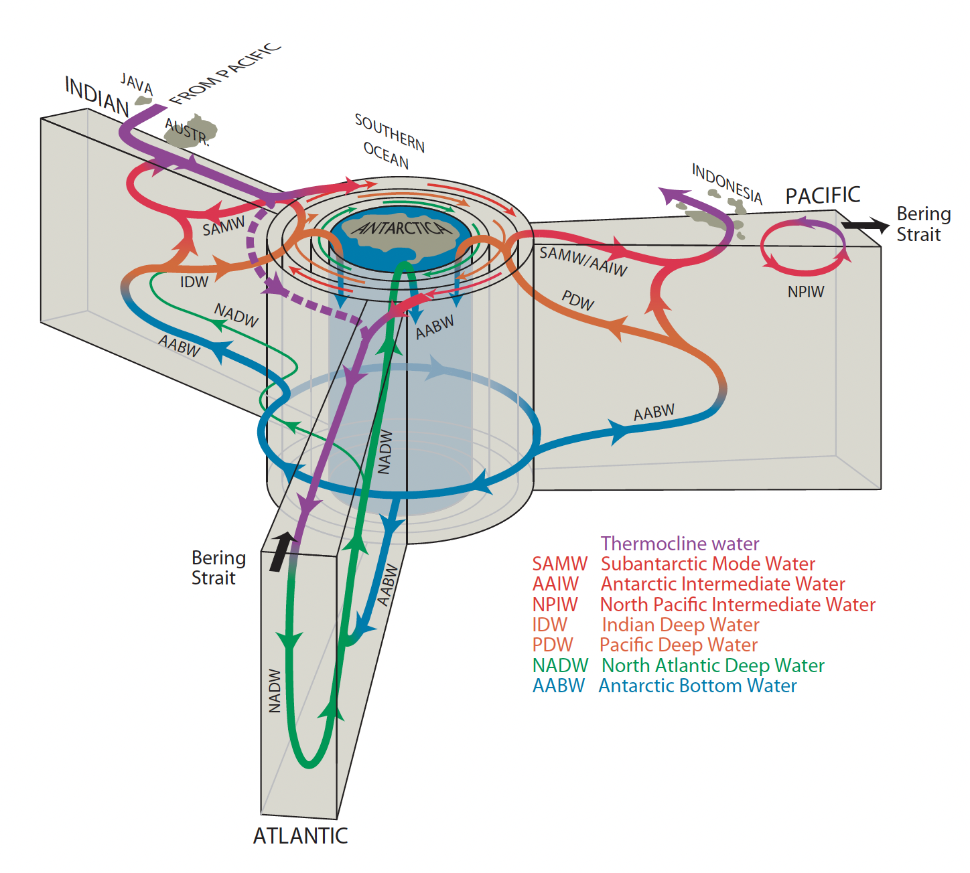
Global Conveyor
AMOC is really one part of the total circulation “highway”
Still plays a key role as one of the main deepwater formation regions
So why is deepwater formation important?
Talley 2013

Slide 11
Deepwater Formation (DWF)
DWF relies on an unstable density regime
Warm surface waters are transported northward…

Slide 12
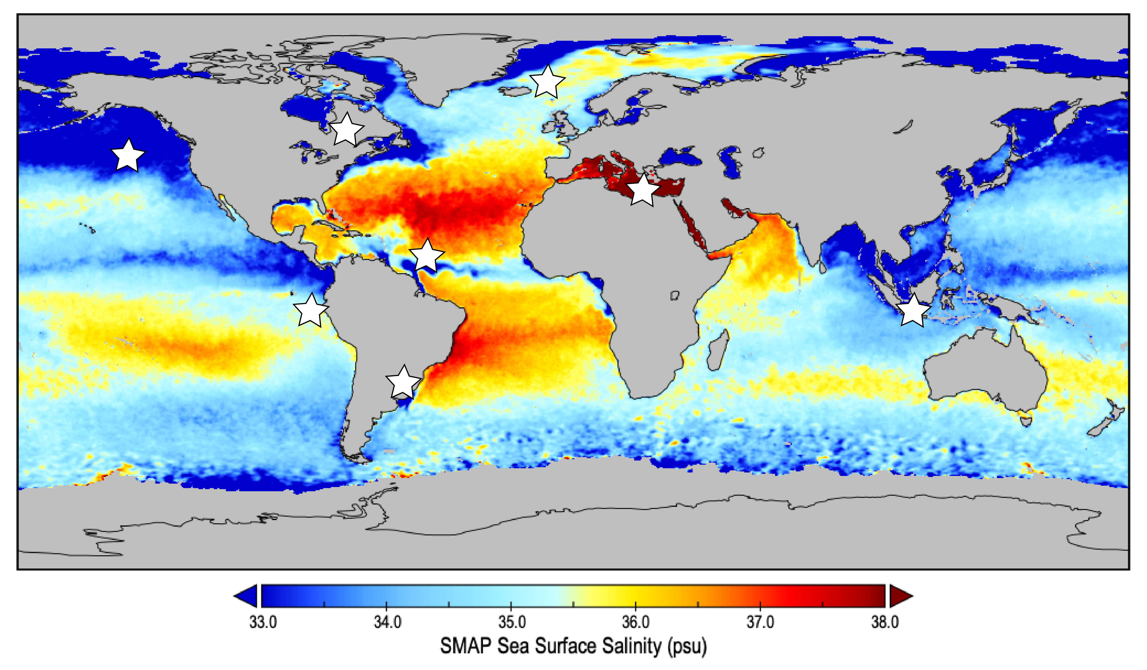
Deepwater Formation
DWF relies on an unstable density regime
Warm surface waters are transported northward…
In the tropics, strong evaporation makes the water saltier (densifies)
https://salinity.oceansciences.org/highlights10.htm

Slide 13
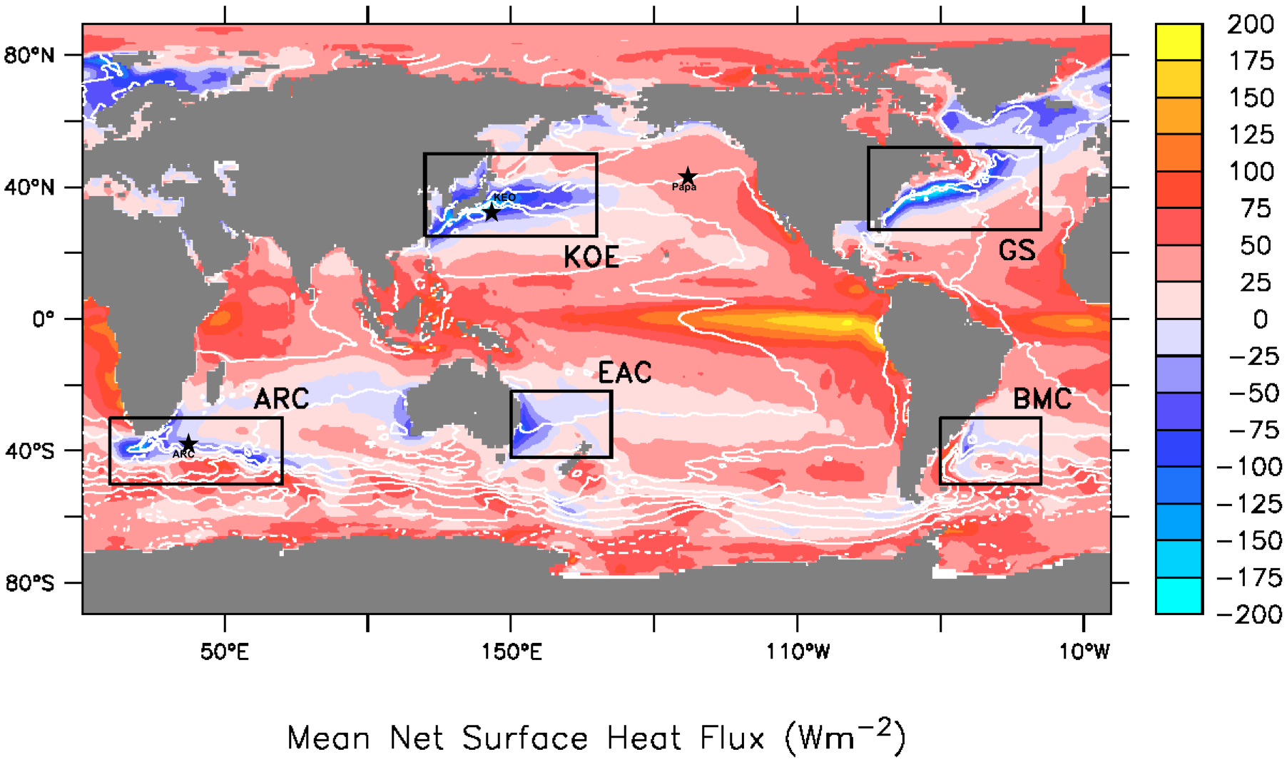
Deepwater Formation
DWF relies on an unstable density regime
Warm surface waters are transported northward…
In the tropics, strong evaporation makes the water saltier (densifies)
These waters eventually reach a polar atmosphere, where it cools rapidly (densifies)
https://www.pmel.noaa.gov/ocs/air-sea-fluxes

Slide 14
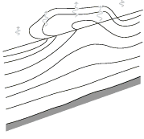
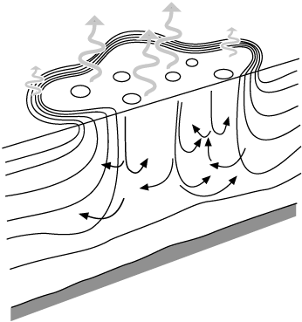
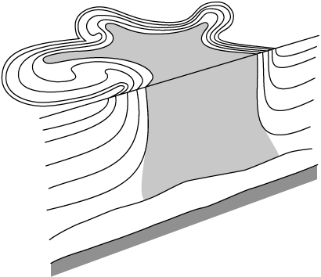
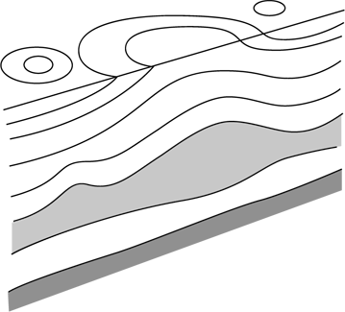
Deepwater Formation
DWF relies on an unstable density regime
Warm surface waters are transported northward…
In the tropics, strong evaporation makes the water saltier (densifies)
These waters eventually reach a polar atmosphere, where it cools rapidly (densifies)
Et Voilà! A recipe for deepwater
https://www.pmel.noaa.gov/ocs/air-sea-fluxes

Slide 15
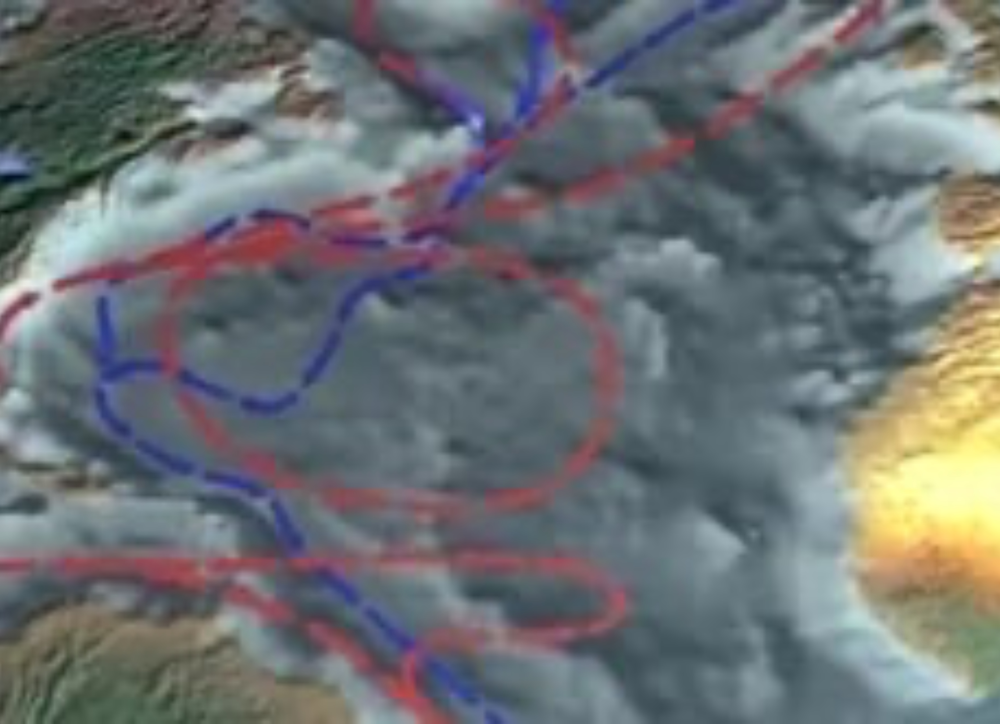
AMOC Disruption
DWF relies on an unstable density regime… Heinrich Events produce a stable density regime
During a Heinrich Event, there is a large discharge of freshwater (decreases density) and cooling
This breaks the chain of the global ocean conveyor belt, causing downstream impacts
https://www.whoi.edu/ocean-learning-hub/multimedia/if-too-much-fresh-water-enters-the-north-atlantic/

Slide 16
So what?
We know that Heinrich Events are associated with the release of icebergs and cooling in the North Atlantic
And this led to further weakening of AMOC
So how does a weakened AMOC impact the rest of the world?

Slide 17
Thermal Bipolar Seesaw
Transport of surface waters acts to warm the north at the expense of warmth in the south
Modifying this pattern changes the interhemispheric temperature gradient
Warm Water

Slide 18
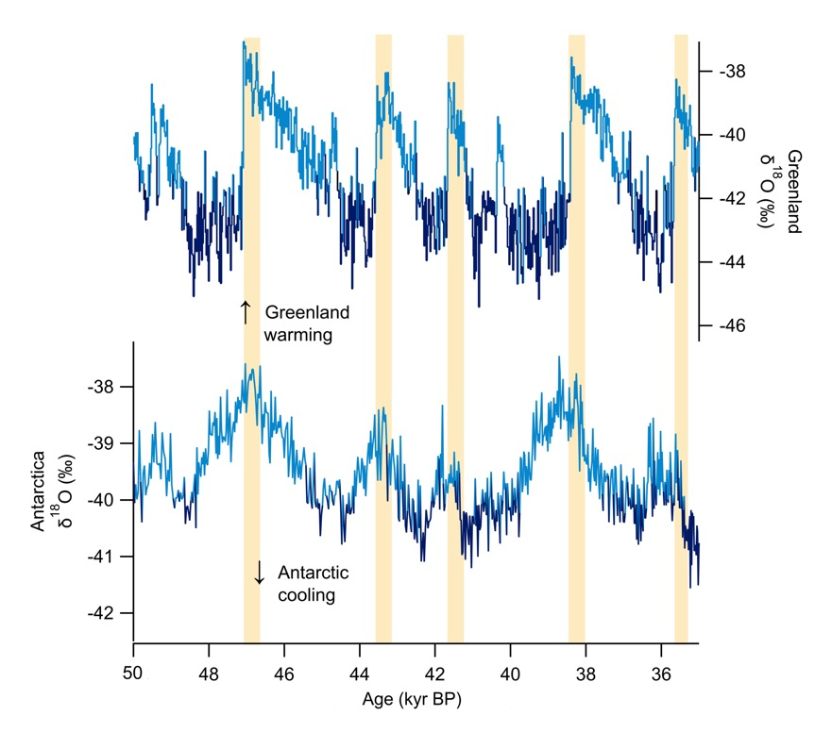

Thermal Bipolar Seesaw
Northern Temperature
Warm Water
Southern Temperature
Wendt et al., (2022)

Slide 19
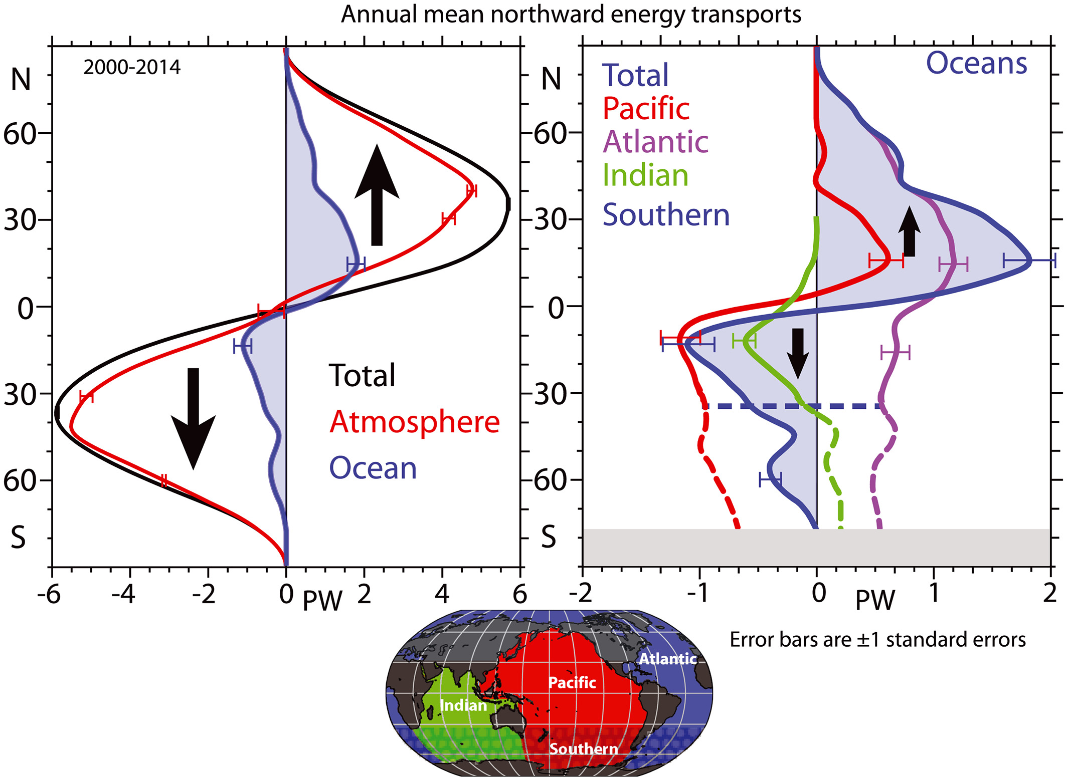
Thermal Equator
With a strong AMOC, the north is warmer than the south
As the energy budget is out of balance, the atmosphere will adjust to transport heat southward
*The Atlantic is the only ocean that transports heat northward everywhere!
Trenbreth and Fasullo (2017)

Slide 20
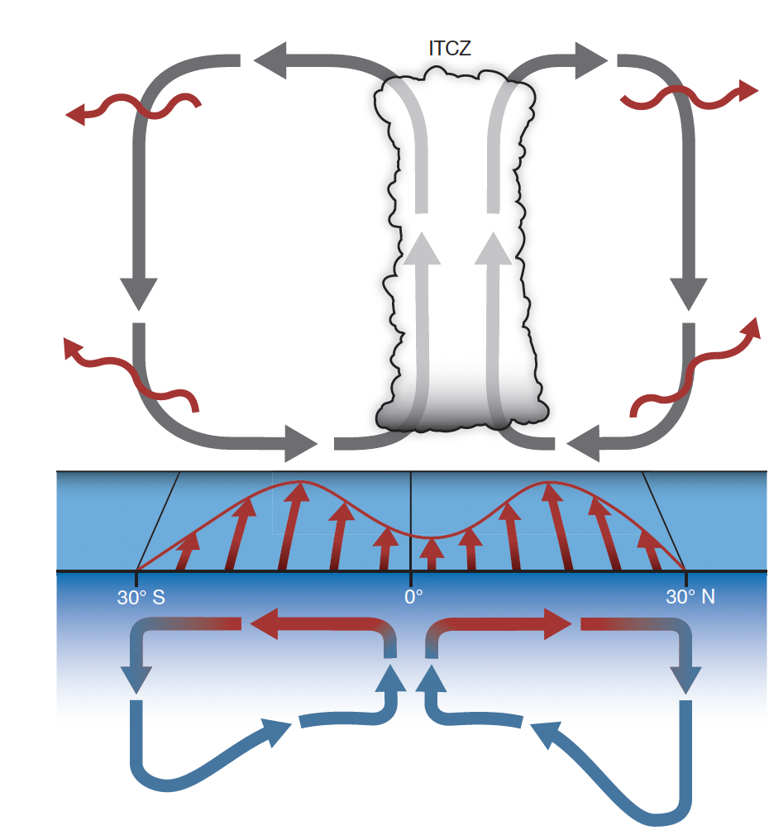
Thermal Equator
With a strong AMOC, the north is warmer than the south
As the energy budget is out of balance, the atmosphere will adjust to transport heat southward
The Intertropical Convergence Zone (ITCZ) follows this boundary very closely
This has an extremely strong control on tropical hydrology
Schneider et al., (2014)

Slide 21
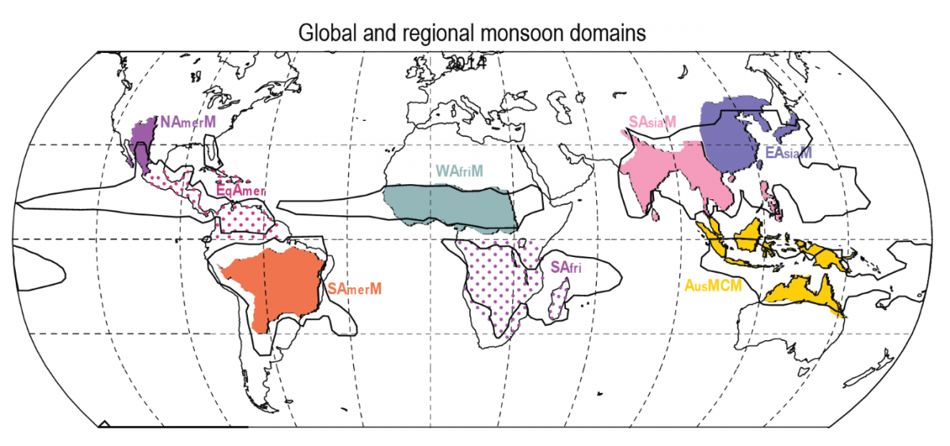
Tropical Monsoons
The ITCZ sets the mean locations of the tropical monsoons
Around 4 billion people rely on monsoon rainfall for water
This is one of the big “why?”’s – over half the planet depends on it!
https://www.clivar.org/panel-about-monsoons

Slide 22
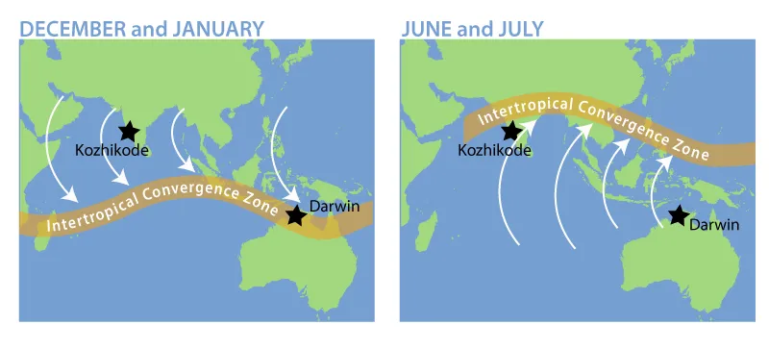
Tropical Monsoons
The ITCZ sets the mean locations of the tropical monsoons
Around 4 billion people rely on monsoon rainfall for water
This is one of the big “why?”’s – over half the planet depends on it!
https://scied.ucar.edu/learning-zone/storms/monsoons

Slide 23
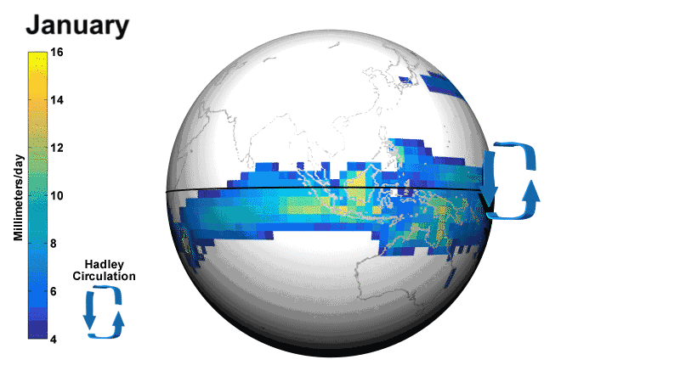
Tropical Monsoons
https://scied.ucar.edu/learning-zone/storms/monsoons

Slide 24
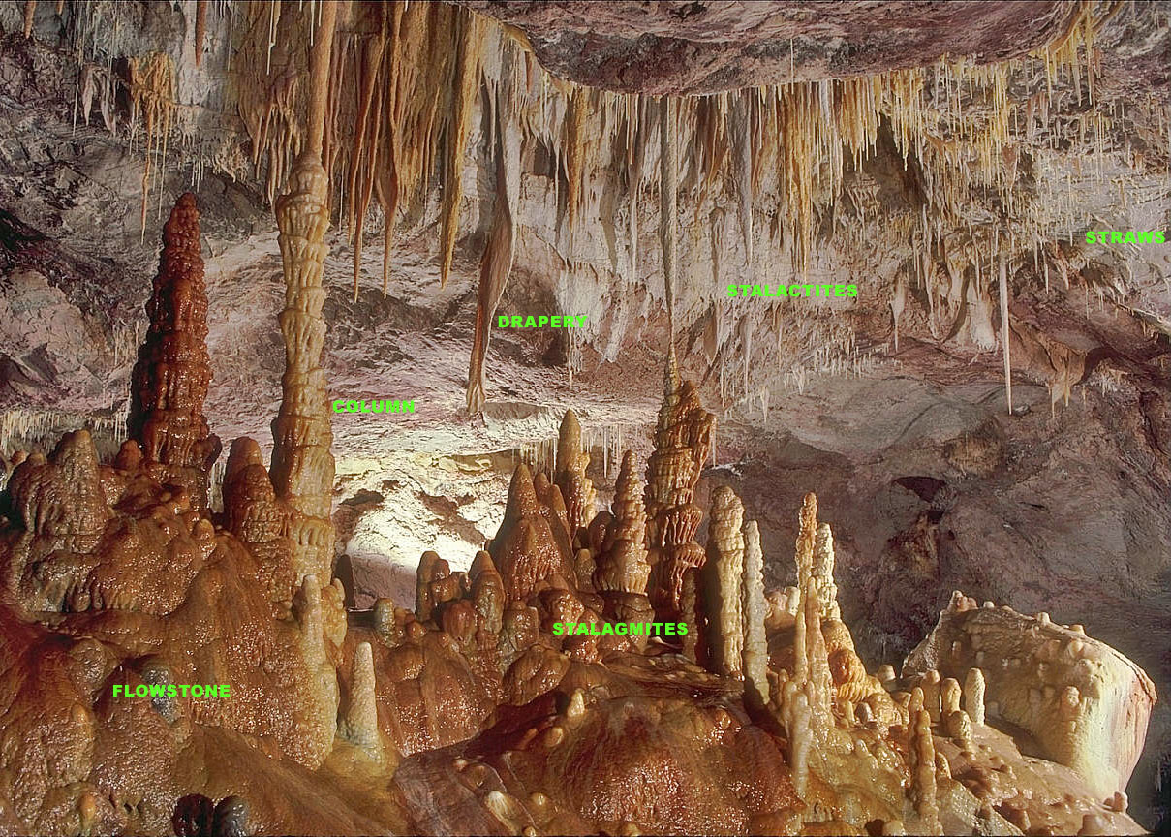
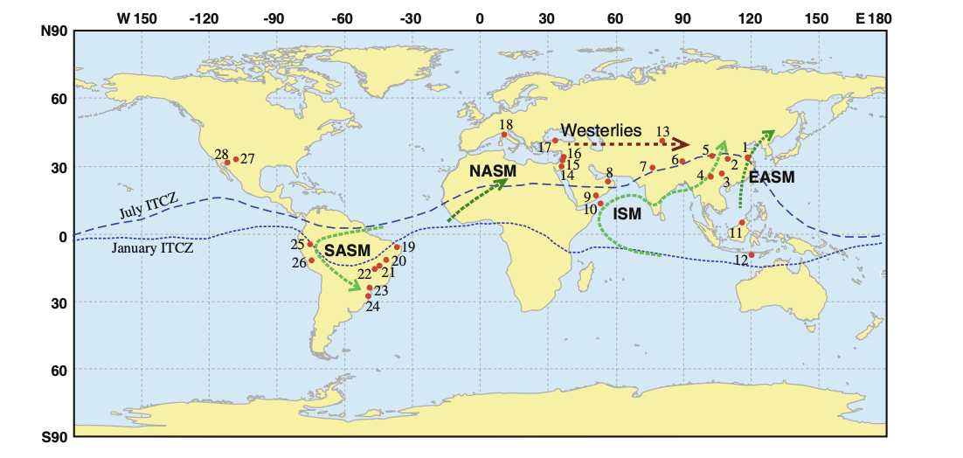
Paleo-Monsoons
Cave deposits (speleothems) are used to reconstruct past monsoon variations
Common within the monsoon regions
We can utilize the oxygen isotope composition of the carbonates which make up stalagmites

Slide 25
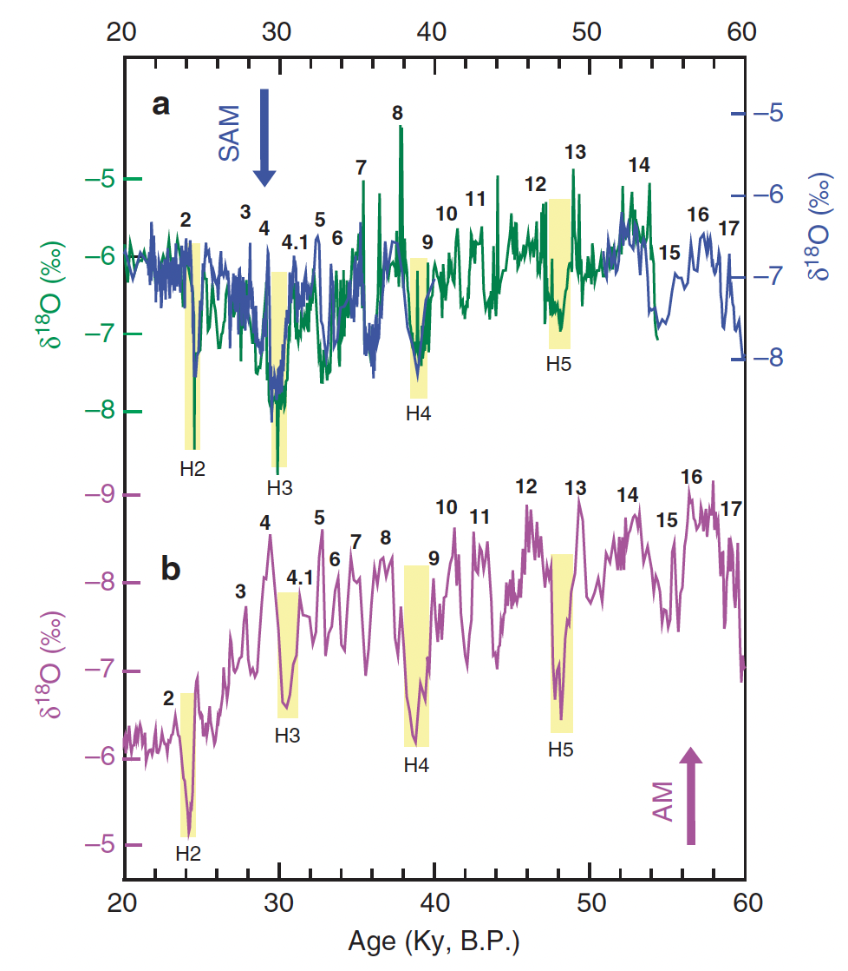
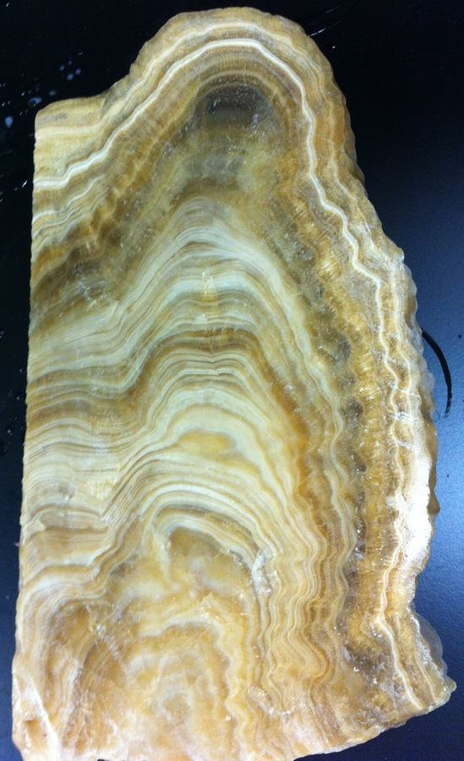
Paleo-Monsoons
South American Monsoon
Asian Monsoon
Cheng et al., (2013)

Slide 26
Anti-phased change
Cave deposits (speleothems) are used to reconstruct past monsoon variations
During Heinrich Events, the South American Monsoon intensifies and the Asian Monsoon weakens
Why?
South American Monsoon
Asian Monsoon
Cheng et al., (2013)

Slide 27
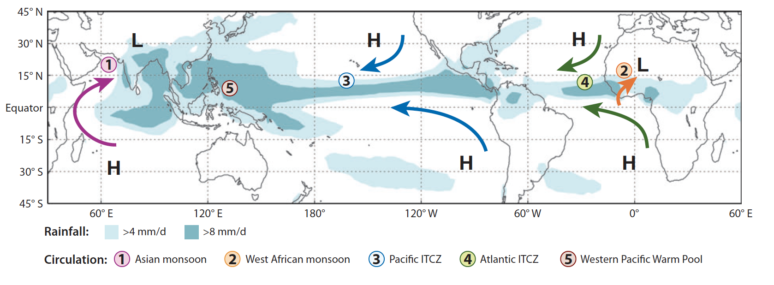
Anti-phased change
Cave deposits (speleothems) are used to reconstruct past monsoon variations
During Heinrich Events, the South American Monsoon intensifies and the Asian Monsoon weakens
Why?
South American Monsoon
Asian Monsoon
Cheng et al., (2013); Chiang (2009)

Slide 28

Does this match the ice cores?
My research at WHOI surrounds investigating changes in ocean energy through ice core reconstructions
So, what is an ice core?
Older ice
Summit
2,000 a
10,000 a
100,000 a
Cross section of the Greenland ice sheet

Slide 29
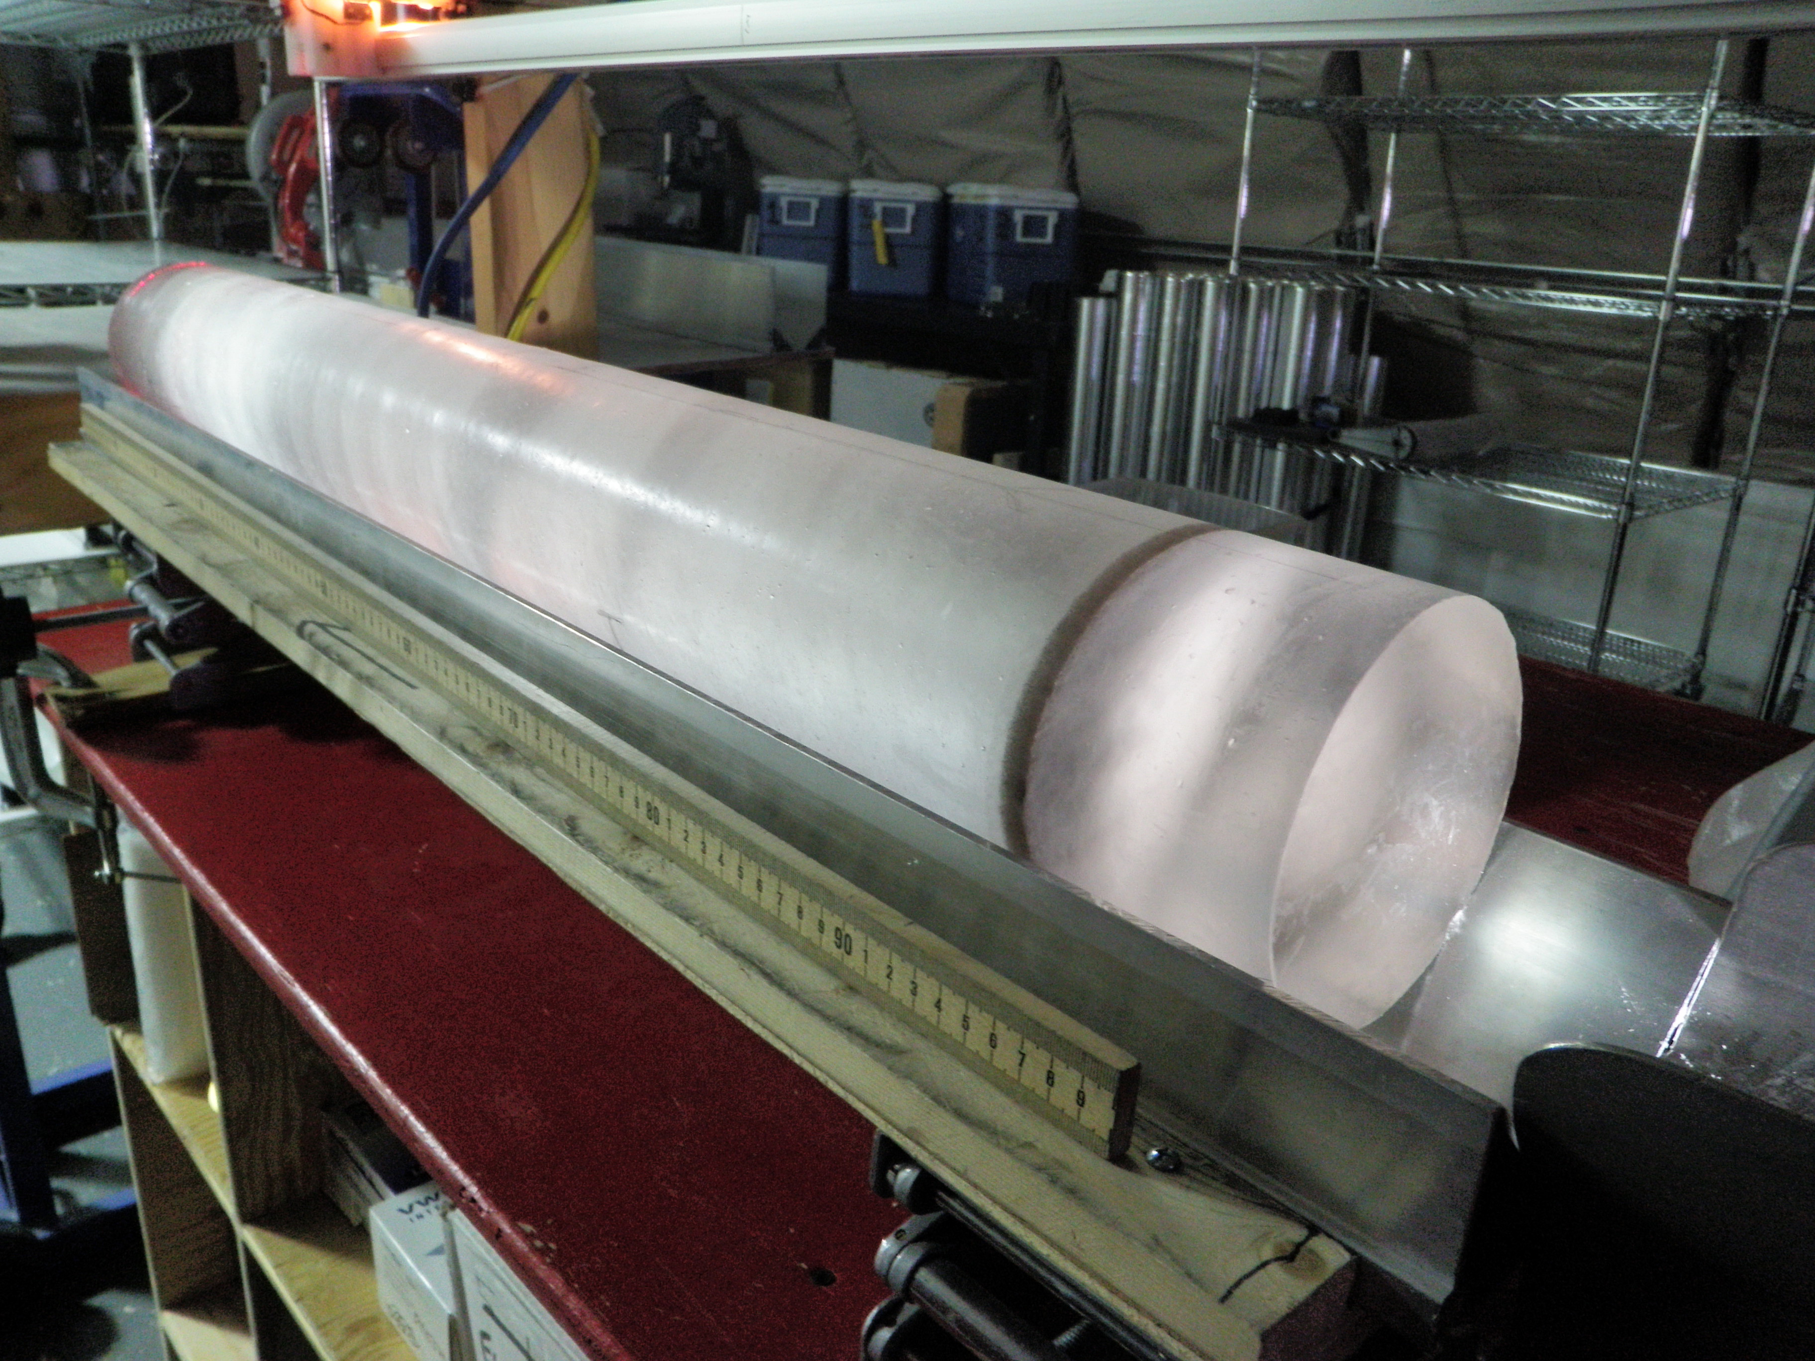

Does this match the ice cores?
My research at WHOI surrounds investigating changes in ocean energy through ice core reconstructions
So, what is an ice core?

Slide 30
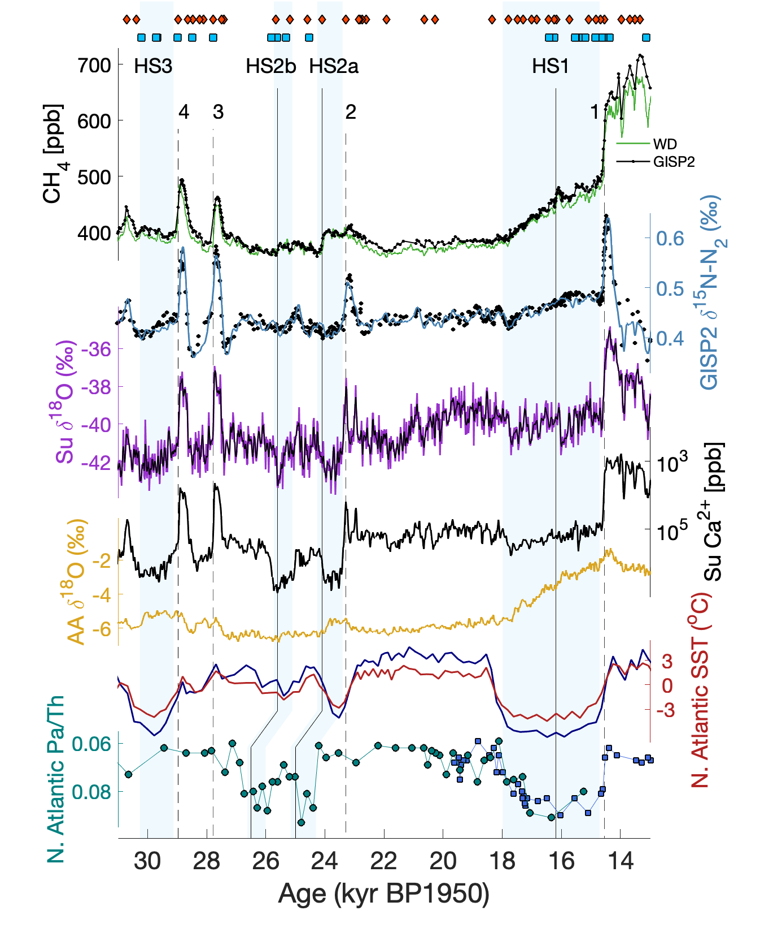
Putting it all together
We can see connections across:
Methane from tropical wetlands
Occurs during Greenland cold periods
Northern Hemisphere becomes drier
Antarctica warms strongly
Open question: does Greenland become colder during the event?
(<- weak) AMOC (strong ->)
Martin et al., (2023)

Slide 31
So what?
We know that Heinrich Events are associated with the release of icebergs and cooling in the North Atlantic
And this led to further weakening of AMOC
Which then impacts tropical hydrology
Are there any other impacts?

Slide 32
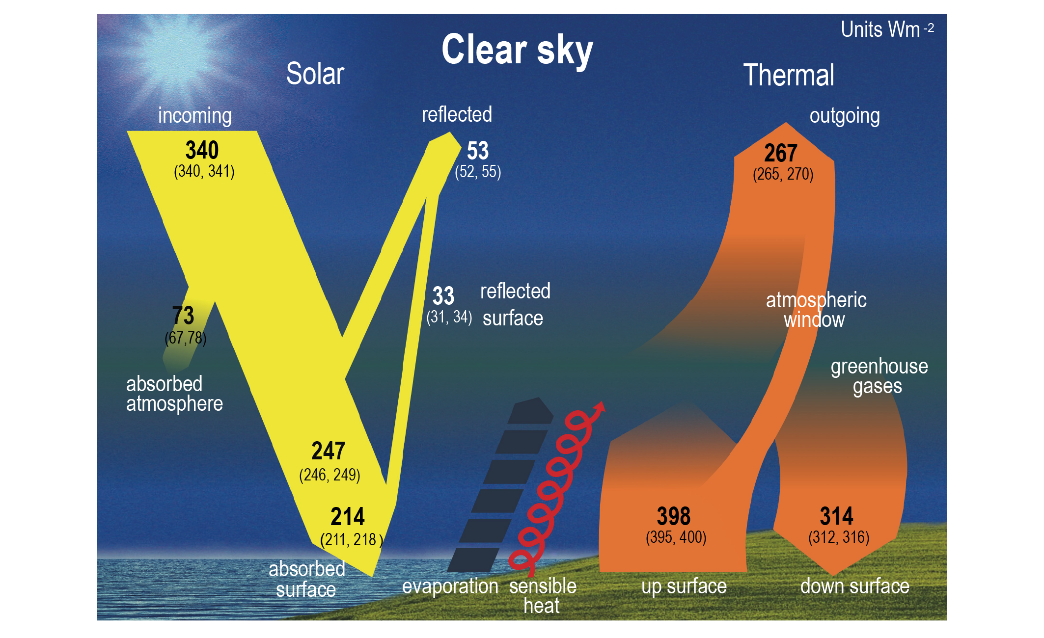
Earth’s Energy Budget
Changes in AMOC also impact the planet’s radiative balance
AMOC not only moves heat northward, but acts to cycle heat out of the earth system
Earth’s Energy = What comes in – What goes out
Earth’s Energy = Absorbed Shortwave –
Outgoing Longwave
IPCC AR6 WG1, Chapter 7

Slide 33
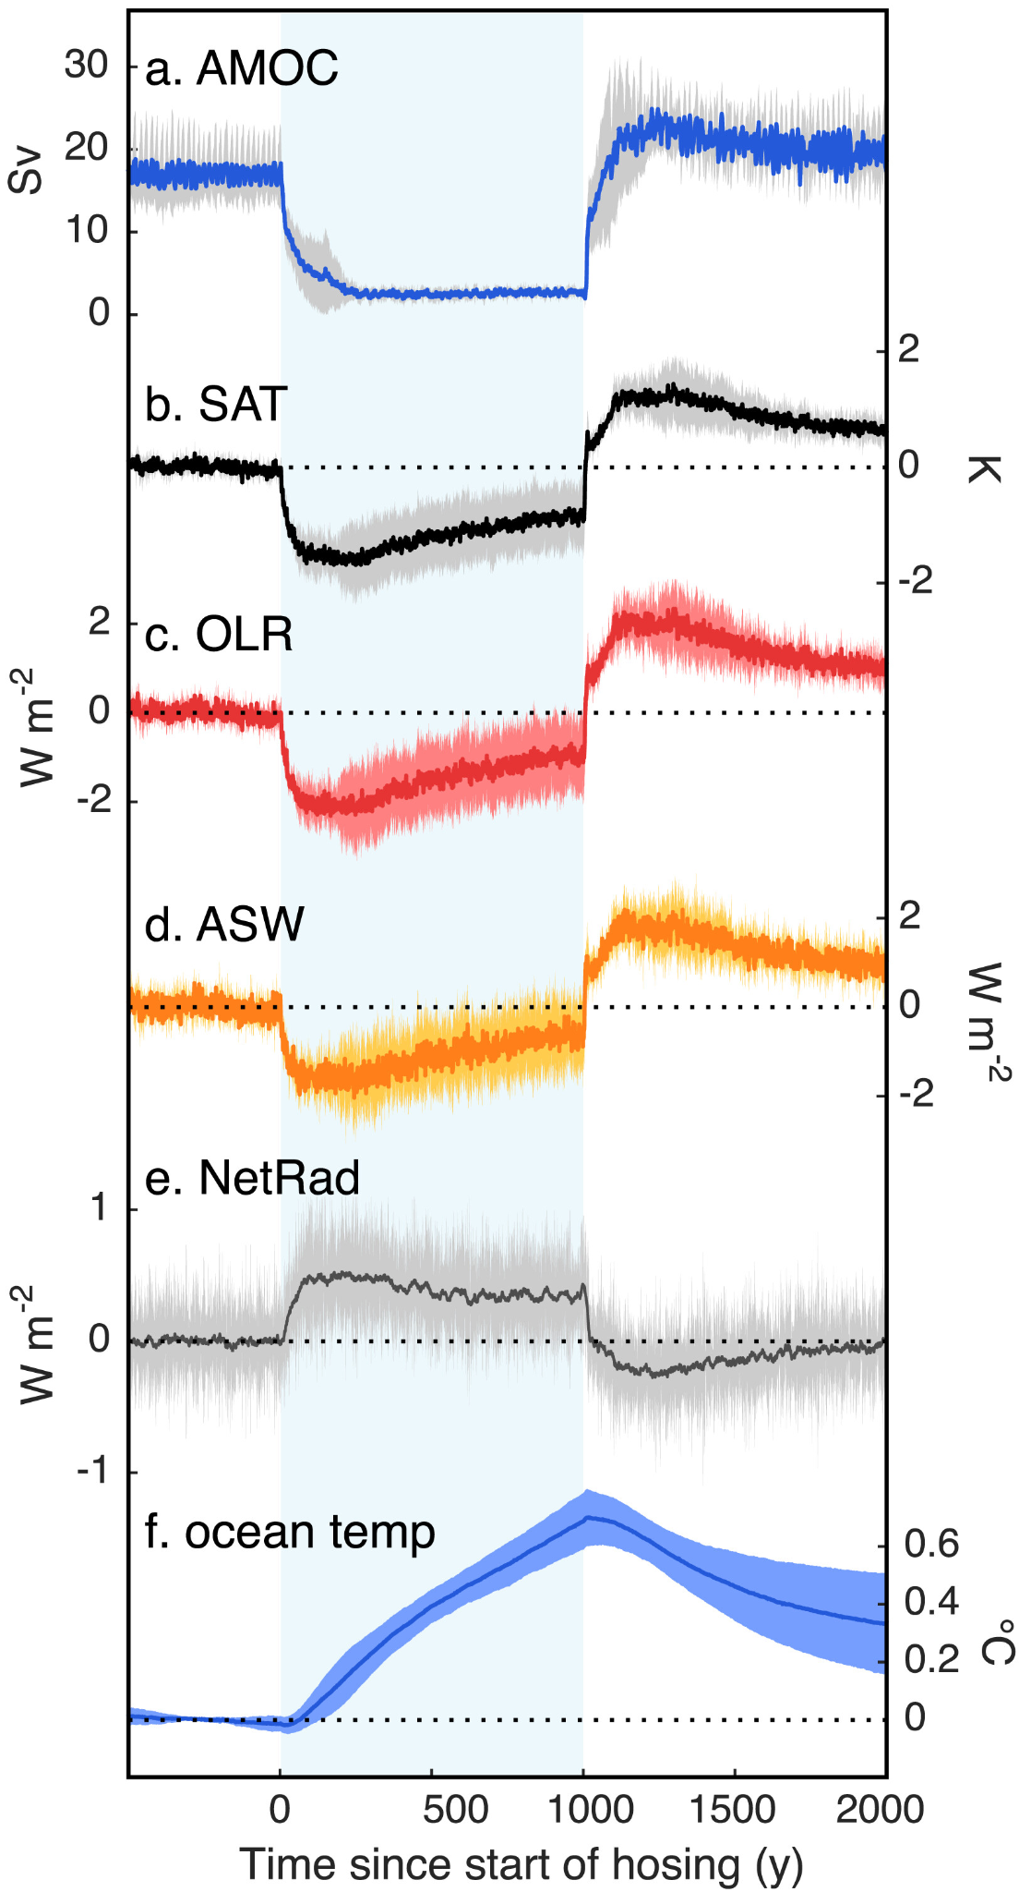
Earth’s Energy Budget
Surface Air Temperature cools as sea-ice and low clouds expand
Outgoing Longwave Radiation decreases because of cooling
Absorbed Shortwave radiation decreases because of increased albedo (reflectivity)
OLR decreases more than ASW, leading to positive net radiation
This extra energy is stored in the ocean!
Galbraith et al., (2016)

Slide 34
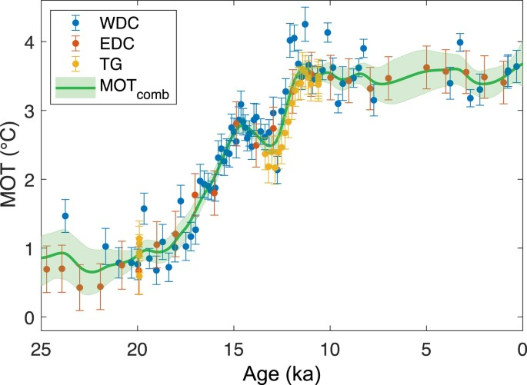
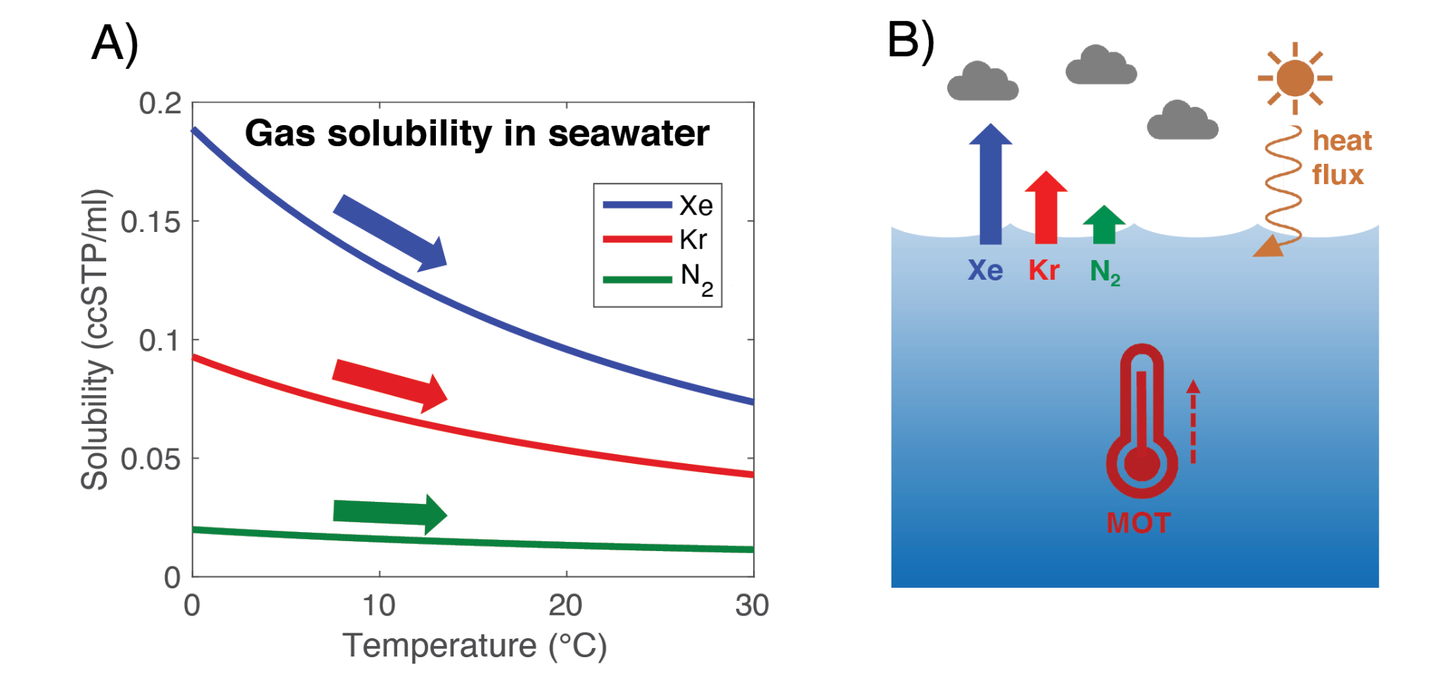
Mean Ocean Temperature
We can reconstruct MOT by measuring noble gases (like Argon, Krypton, Xenon) because of their solubilities
Cold water holds more gas than warm water, so during periods of cooling gases dissolve into the ocean
This leaves the atmosphere with less gas, which is recorded in an ice core
Shackleton et al., (2023)

Slide 35
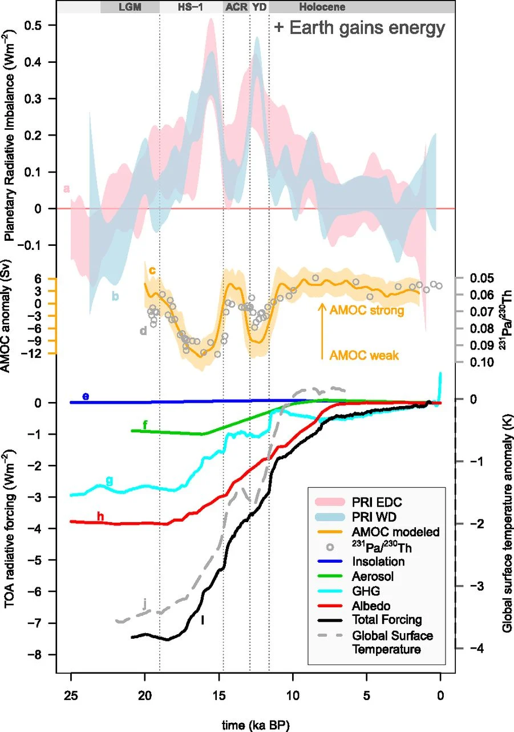
Mean Ocean Temperature
The ocean is the dominant energy reservoir on the planet*
Over 90% of the current anthropogenic warming is absorbed by the ocean
Using MOT, we can assess changes in the energy budget
The largest changes occur around Heinrich Events!
Baggenstos et al., (2019)

Slide 36
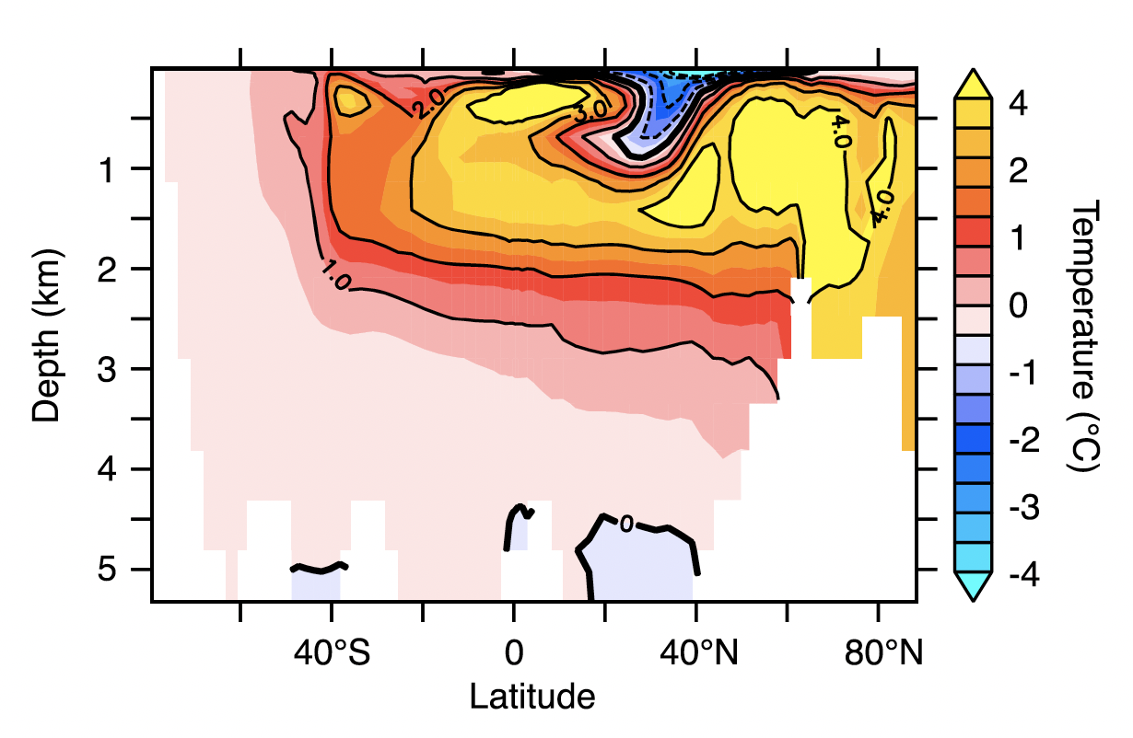
Subsurface Warming
The storage of this extra energy in the ocean is one of the leading hypotheses for the cause of Heinrich Events
Deep warming can destabilize ice sheets if they are connected to the ocean (marine terminating)
Galbraith et al., (2016)

Slide 37
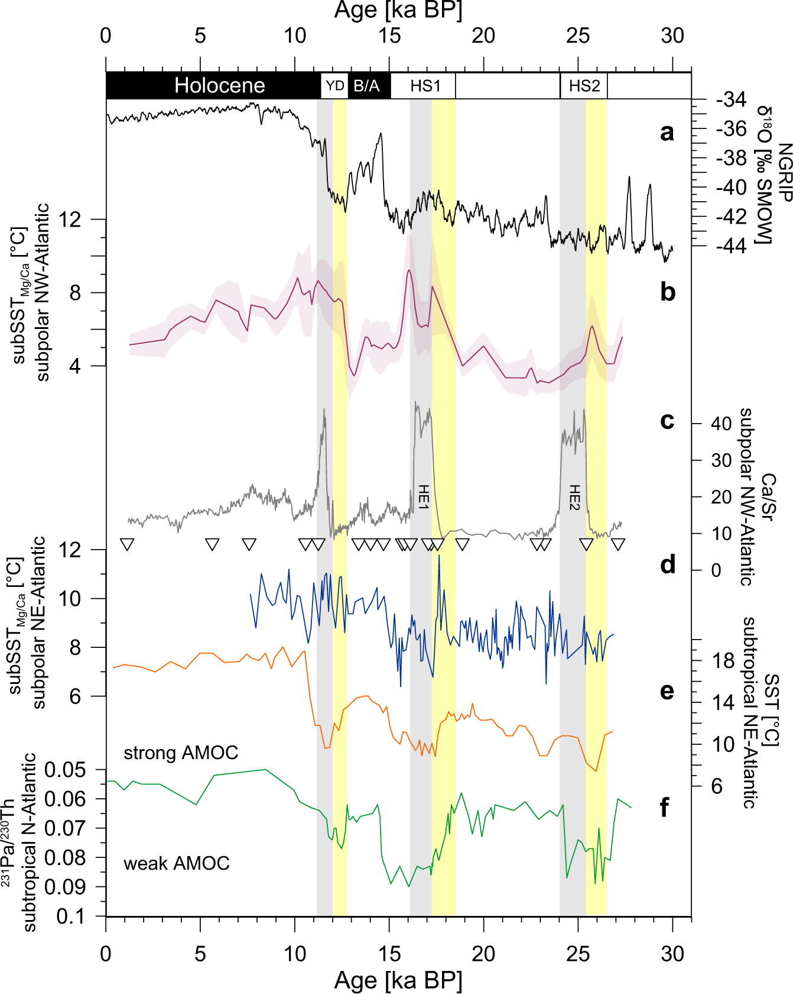
Subsurface Warming
The storage of this extra energy in the ocean is one of the leading hypotheses for the cause of Heinrich Events
Deep warming can destabilize ice sheets if they are connected to the ocean (marine terminating)
Max et al., (2022)

Slide 38
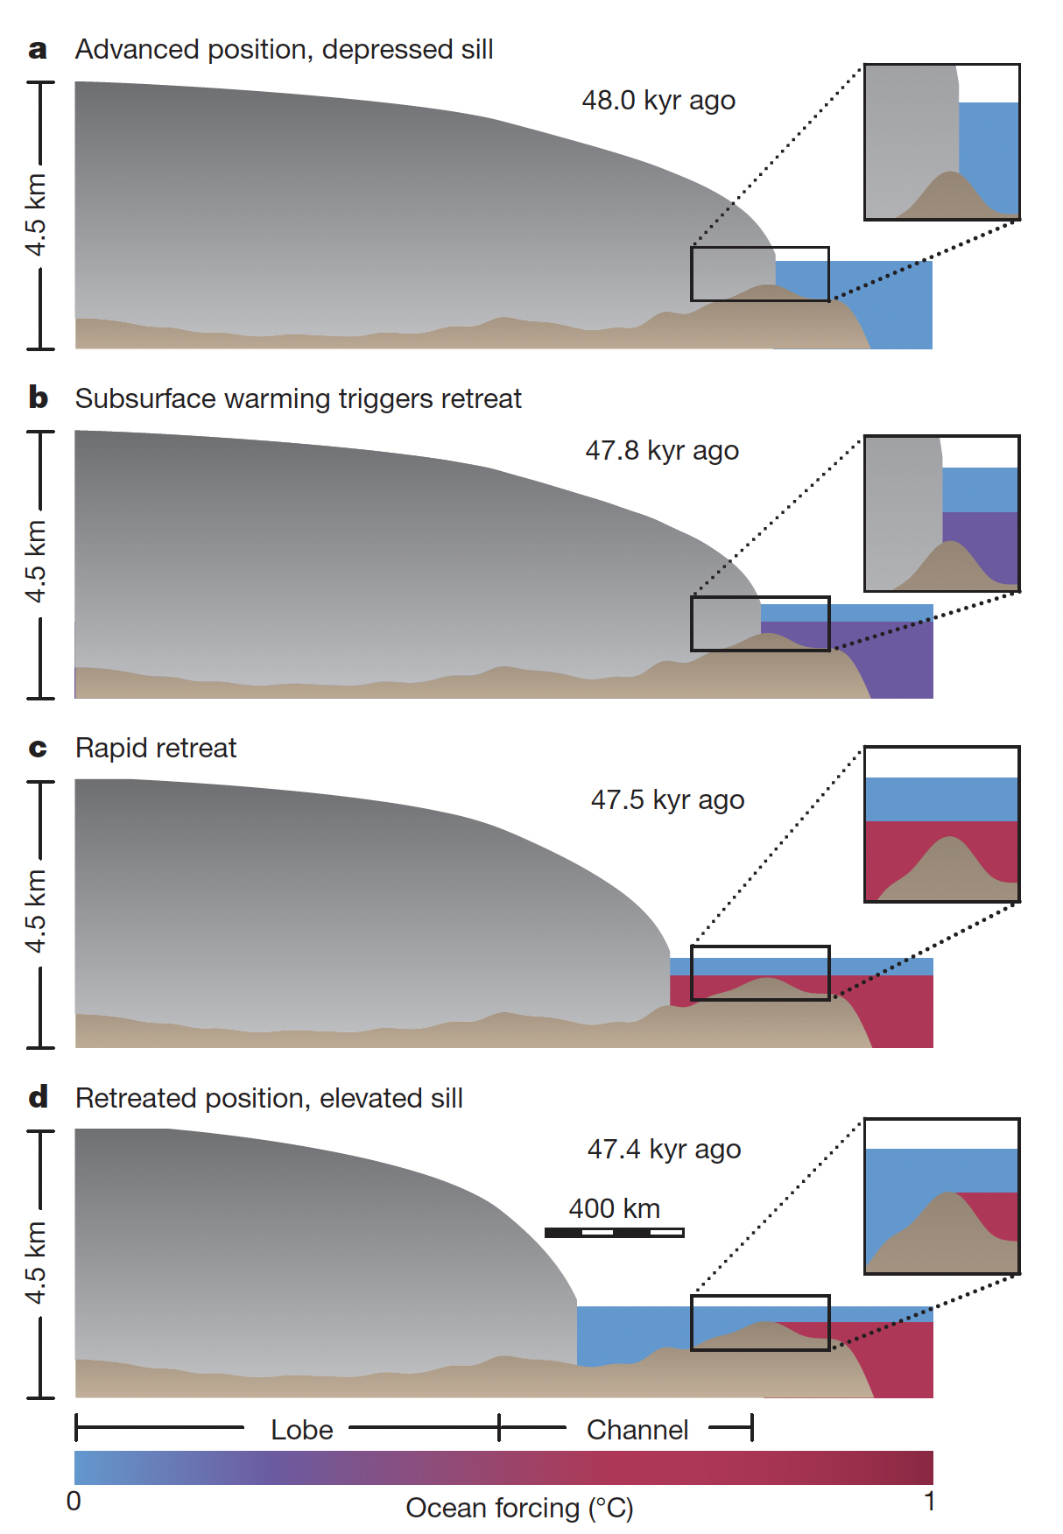
Subsurface Warming
The storage of this extra energy in the ocean is one of the leading hypotheses for the cause of Heinrich Events
Deep warming can destabilize ice sheets if they are connected to the ocean (marine terminating)
Bassis et al., (2017)

Slide 39
Why does the world care about icebergs?
Past periods of iceberg discharge allow climate scientists to explore the impacts of a reduced AMOC
It changes Tropical Hydrology - over half the planet relies on monsoonal rainfall
It amplifies warming – while these are periods of extreme cold in the past, they result in strong warming
Open questions still surround these events
Glaciology – how do marine terminating ice sheets respond to ocean warming?

